Slide 1
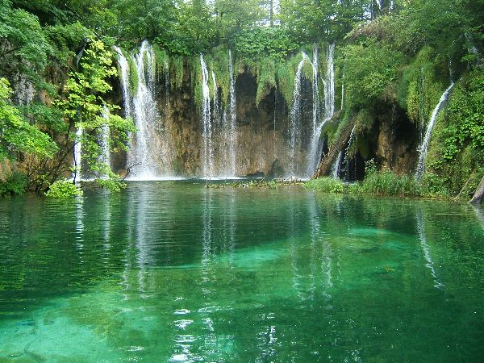
Freshwater biomes
Notes:
Elements of the physical environment – as the nature of the substrate, depth of the water, velocity of flow and water chemistry determine the patterns of life in these systems, in which large plants are relatively minor components. The distribution of life in freshwater biomes is controlled in part by the substrate. Different forms tend to inhabit rocky bottoms than sandy and muddy. Water chemistry and water temperature are also important factors. Especially significant are the amounts of dissolved oxygen and carbon dioxide and the amount and kind of dissolved salts.Turbulence in the water determines where nutrients may settle to the bottom and when the mixing occurs. Seasonal change is a fact of life in all aquatic environments.

Slide 2
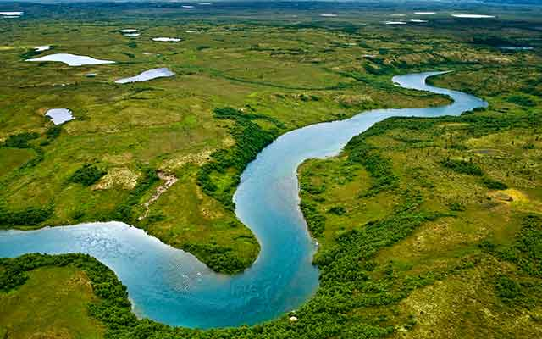
Rivers and streams
Notes:
Flowing waters – lotic environment, make up only 0,0001% of the world´s water. The channelized water of a stream moves in one direction, downslope, and yet plants and animals do not all get washed out of a river system because they have evolved adaptations that allow them to maintain a particular horizontal position in a stream. Life in streams depends mostly upon sun energy which convert to food by land plants growing along the banks and overhanging the river and enters the water as dead leaves and falle branches and stems. Water hardness is a measure of the calcium and magnesium occuring in the water as salts. In general, the greater the hardness, the more varied life is in a stream. Stremas are influenced by regional climate, most obviously by the amount and seasonality of precipitation. As the flow changes, the amount of sediments carried or deposited by a stream varies, and thus the composition and depth of channel sands and gravels are never constant.

Slide 3
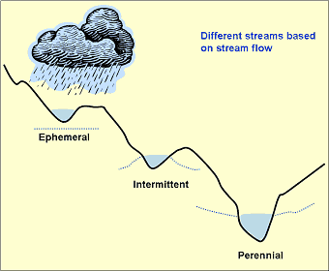
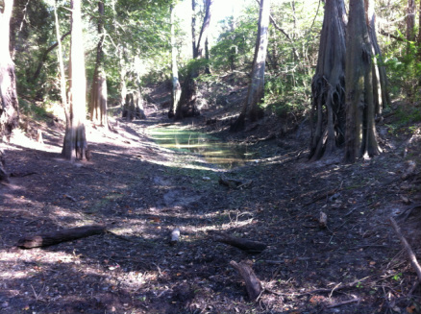
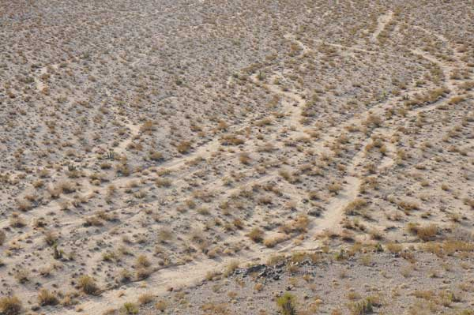
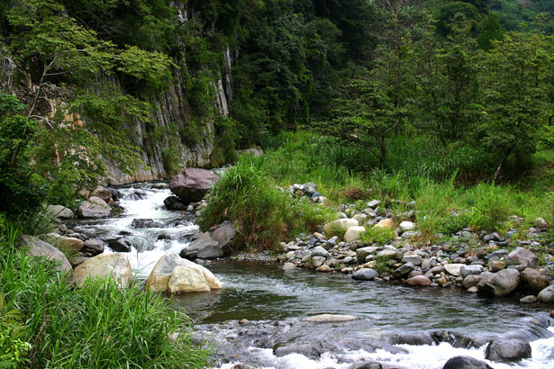
Notes:
Different types of streams are recognized according to their annual pattern of water flow.
Permanent streams – maintain water in their channels all year. In arid areas, they typically receive almost all of their water in humid areas near their source
Intermittent streams – carry water only for 3 or more months, much of the year their channels are dry. They are characteristic of arid and semiarid climate regions, where they flow during the rainy seasons.
Ephemeral streams – in deserts; water flows in their channels only for a few hours or days after significant rainfall and even that is rare and unpredictable from year to year.

Slide 5
Stream environment
Notes:
The idealized stream begins at a spring or seep at high elevations and becomes a torrent in the mountains, where the course is steep and full of waterfalls and the flow is shallow, fast and turbulent. The stream bottom is solid rock, and the channel contains large boulders.

Slide 7
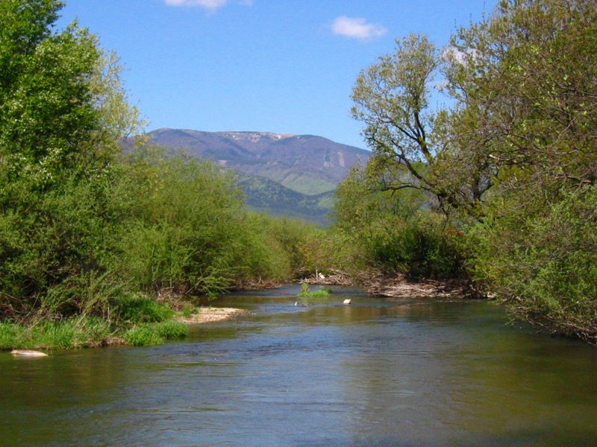
Notes:
Downstream the character of the stream changes as the watershed increases in size and more water flows in the channel. The gradient becomes less steep, and the water is less turbulent, and the stream corse begins to meander as the river starts to cut lateraly into sides of its valley.

Slide 8
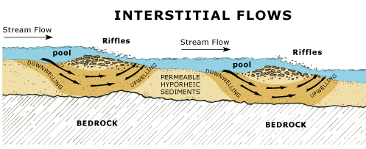
Notes:
This creates a regular pattern of shallow riffles, intermediate runs, and deep pools – each a distintly different habitat.

Slide 9
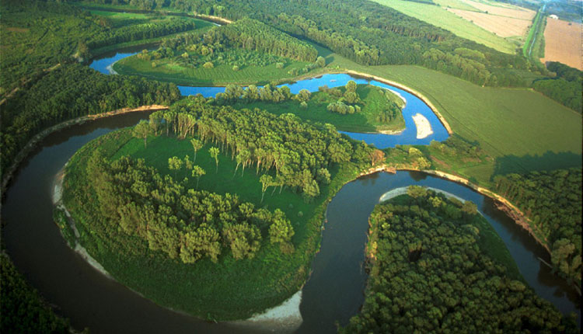
Notes:
In the meanders, the outer banks are undercut, but deposition of sands and gravels occurs on the inside of each bend.

Slide 10
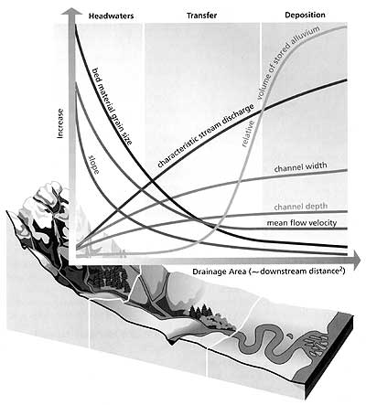
Notes:
As a river continues downstream, it typically gets larger and larger becuase more tributaries discharge their water into it and water seeps in from groundwater. The river becomes wider, deeper and fater, but its slope flattens. In lower reaches, the river bottom is usually sandy.

Slide 11
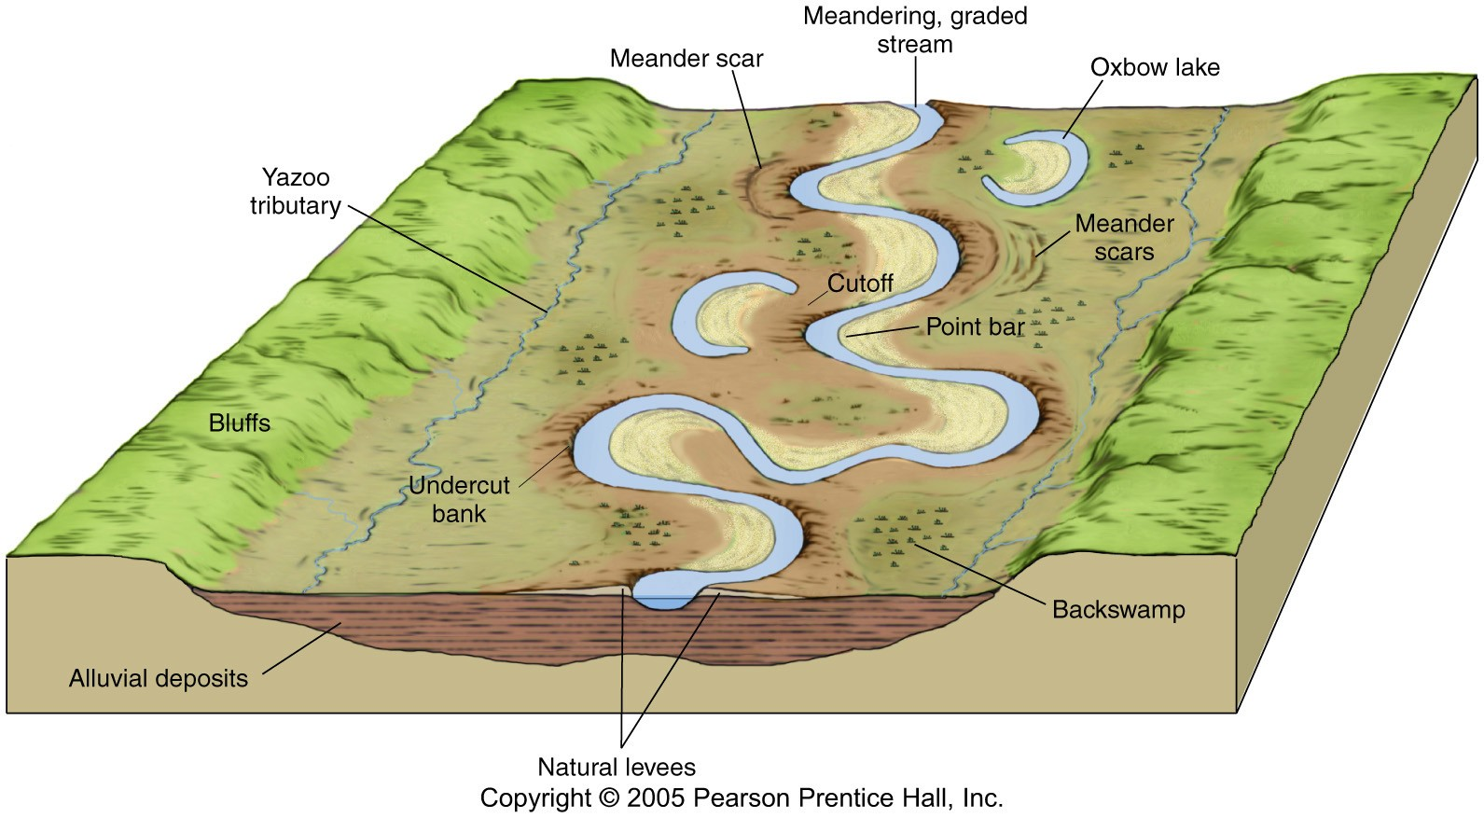
Notes:
As a river widens its valley, it builds a floodplain – a flat valley bottom of alluvium deposited each time the river overflows its banks. Receiding waters may leave depressions on the floodplain filled with water – floodplain lakes – and lowlying land close to the channel waterlogged and covered with freshwater marshes or swamp. Organisms in this area must be able to tolerate changes in water volume and the effects of flooding.
The water environment varies between upstream and downstream reaches of a river and within the water column and across the stream at any point. Flow is smooth and swiftest in the centre of the water column. Stones and boulders in the channel introduce small but important differences because their lee or downstream sides offer still water and shelter from the fast currents near the centre of a stream. Finally, the shade of overhanging plants near the banks can cause differences in light across the width of a channel.

Slide 12
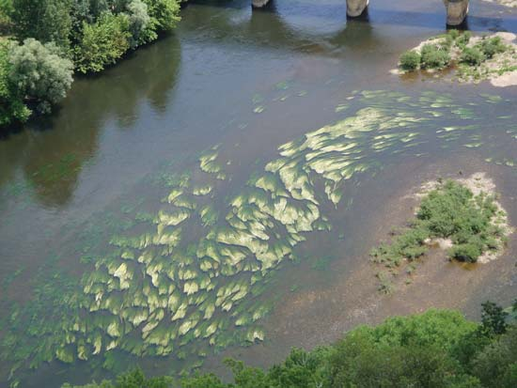
Plants
in fast-flowing upland streams – red algae, mosses, liwerworts
in tropics and subtropics – flowering plants of family Podostemonaceae
Notes:
Podostemonaceae have no roots, but are anchored to rocks with holdfasts – flattened discs similar to those of some seaweeds. The entire plant is only few cm tall. Most macrophytes are found on the lee side of rocks where they form crusts.

Slide 13
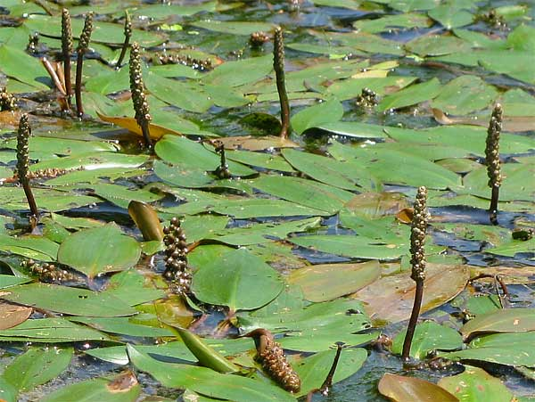
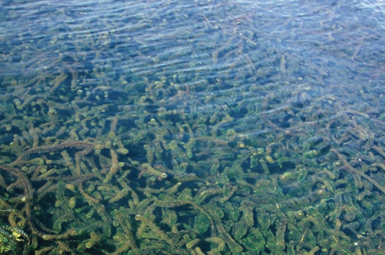
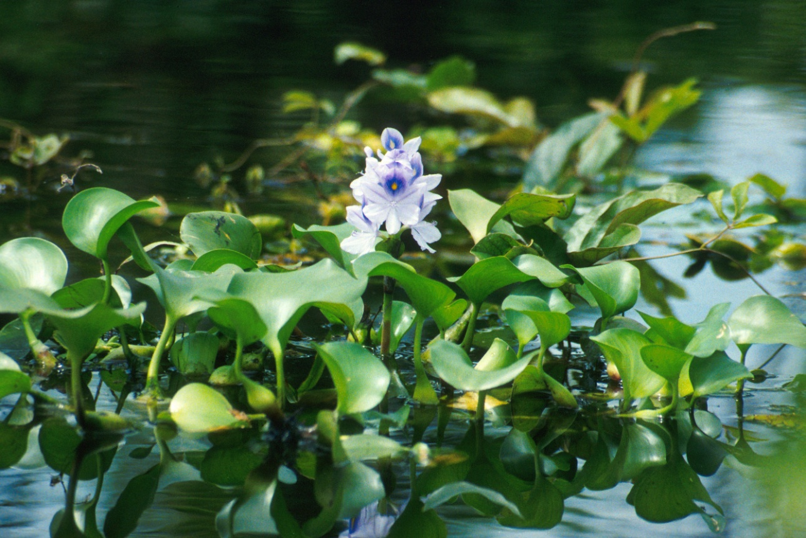
Potamogeton nodosus
Elodea sp.
Eichhornia crassipes
Notes:
In the lower reaches of rivers, water depth and high sediment load may prevent submergent plants from growing on the stream bottom. Nearer the banks, however, where water is more shallow, rooted emergents and submergent plants may find suitable habitat. These are mostly flowering plants that have evolved from terrestrial ancestors, because they still have flowers pollinated by wind or insects, they bear them above the water. They usually have air-filled spaces in tissues which give them support. Pondweeds and plants with floating leaves are typical in slower, nutrient-rich waters. In the lowland parts of large tropical rivers, mats of floating plants such as water hyacinth commonly move downstream along the sides of the river beyond the main channel.

Slide 14
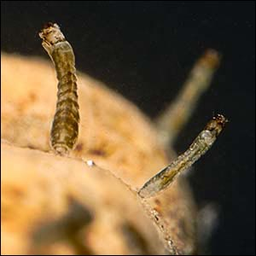
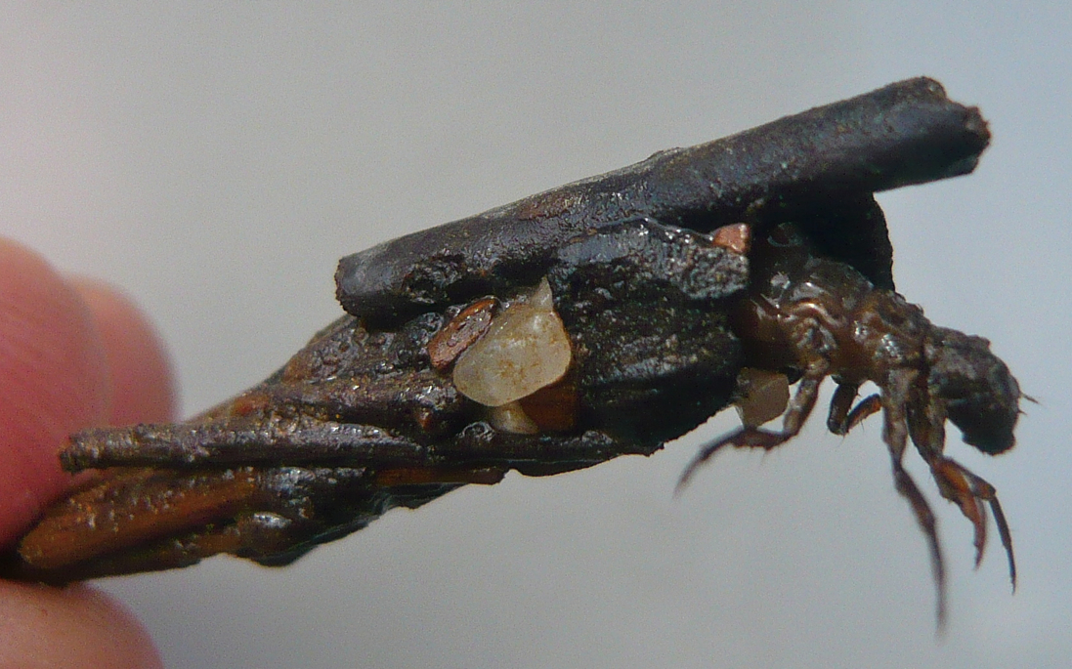
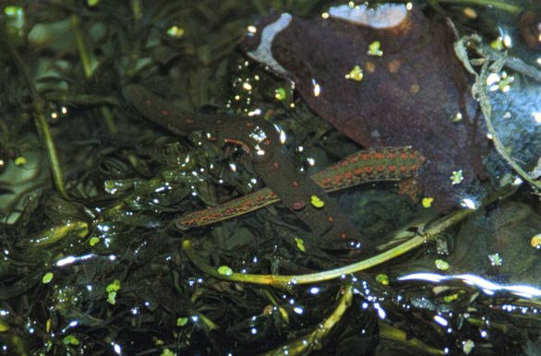
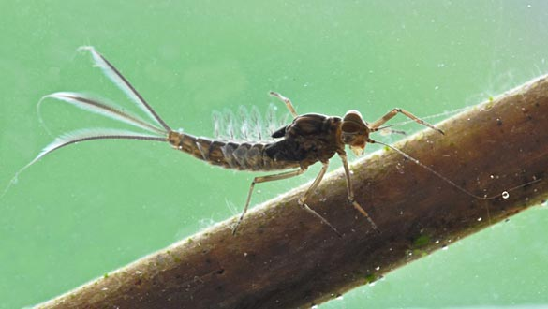
Animals
Notes:
Since most animals in streams move freely, they have evolved a number of adaptations to prevent their being swept downstream. Permanent attachment would likely be nonadaptive since animals could easily be stranded and exposed to the air when water level dropped. Common adaptations include a streamlined body shape.
Suckers or suction pad feet help leeches, limpets and snails adhere to surfaces
Hooks, grapples and clawlike legs form the same function for other insect larvae. The larvae of caddisflies construct cases of heavy particles that act as ballast to keep them from floating up into the currents. Blackfly larvae attach themselves to rocks by hooking onto pads of silk they create. The larvae of butterflies and moths temporarily fasten themselves in cocoons. Sometimes seasonally, sometimes daily, depending upon the animal, invertebrates let go and drift downstream short distances. This drift may help them find new food sources or avoid predators.
Caddisfly, mayfly, blackfly, leech

Slide 15
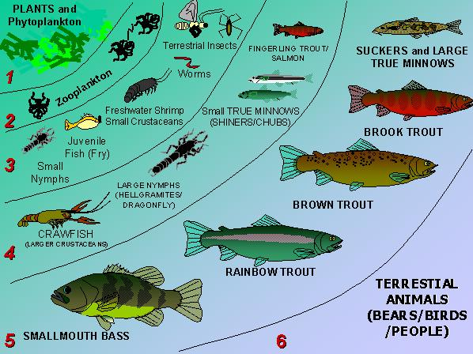

Slide 16
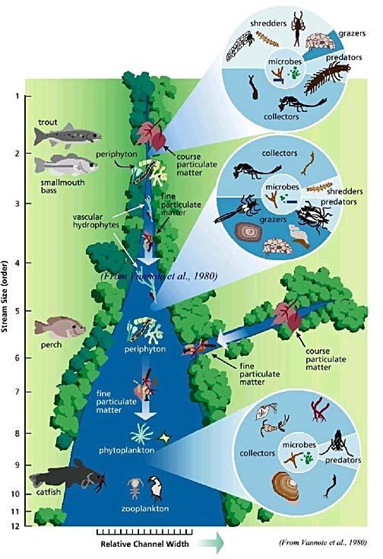
Notes:
The compositiono of the animal community tends to change in the progression from first-order streams to floodplain streams. Lower-order stremas are inhabited by animals such as trout that require cool temperatures and high concentration of dissolved oxygen. Organisms associated with hard surfaces are also more prevalent in these uplnad streams. Higher order streams have many more animals that can tolerate warmer waters, more nutrients but less oxygen dissolved.

Slide 17
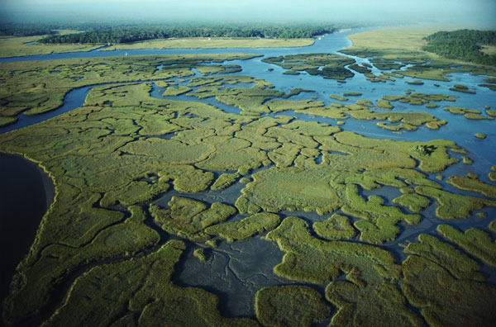
Freshwater wetlands
Notes:
Rivers and their floodplain or delta wetlands are parts of the same ecosystem, lathough they may be separated from each other seasonally. Wetlands are often very important conservation areas.

Slide 18
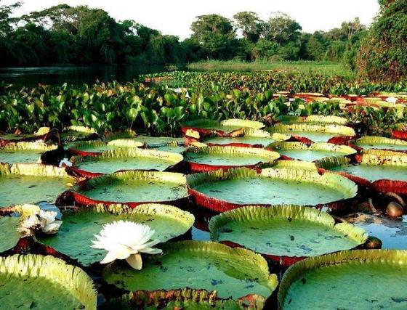
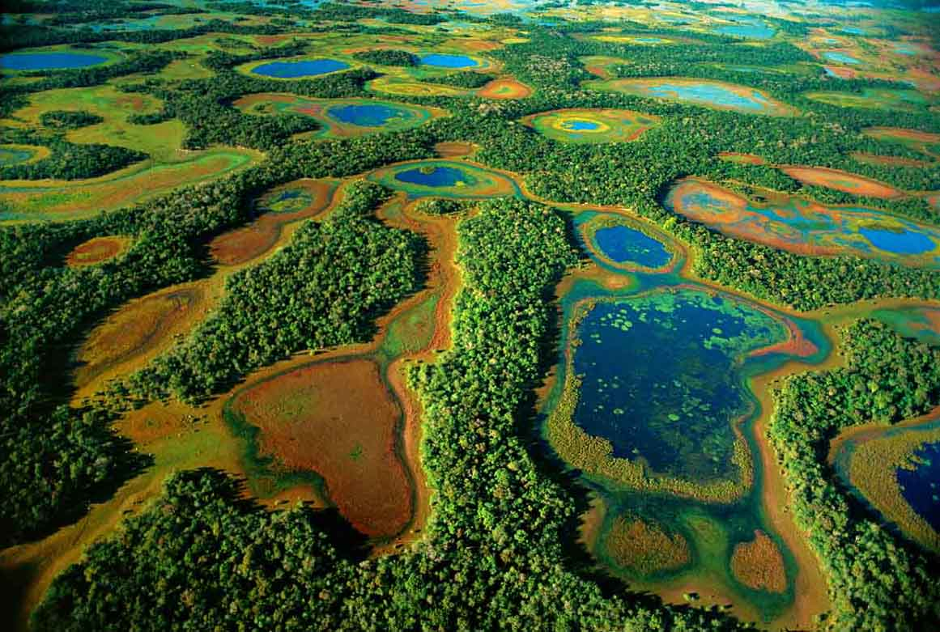
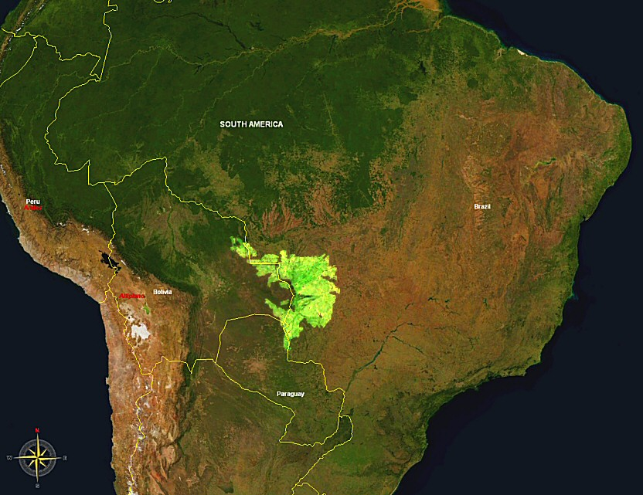
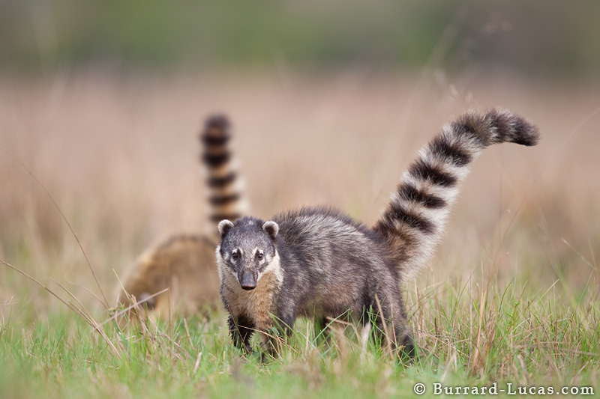
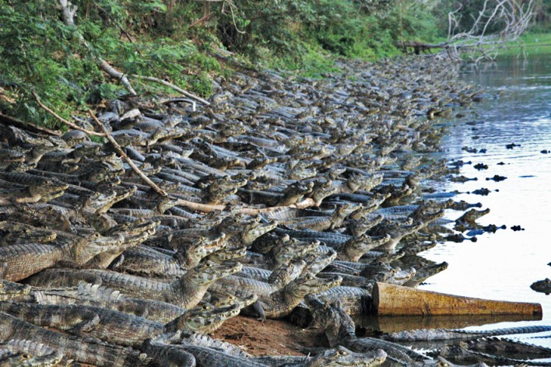
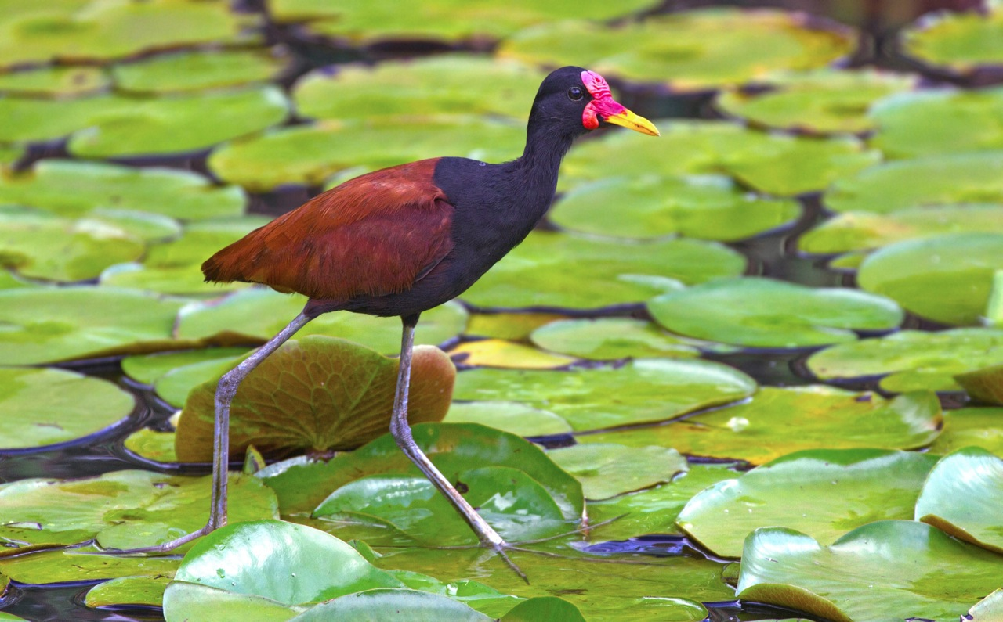
Notes:
One of the largest floodplain wetlands on Earth is the Pantanal in Brazil, where it is recognized as a biome in its own right. The upper Paraguay River and its tributaries inundate over 100 000km2 for up to 7 months (November to May) each year. This watery region contains thousands of small lakes renewed each year by flood, marshes and swamps and vast areas covered with floating plants. Scattered islands of higher ground stand above the flood and serve as refuges for land plants and animals. About 40 different plants make up the floating vegetation – the highest diversity in the world – among them are water hyacinth, water cabbage, floating fern. The mats of floating plants rise and fall with the changing water levels and are thick enough to support the weight of jacana, which can feed and nest on the plants. The extremely abundant small crocodilian, the jacaré also nests on the mats, where its eggs are vulnerable to coatimundi and forest dogs. Dead plant matter accumulates and decays beneath the floating mats and creates conditions of low oxygen. The world´s most diverse community of air-breathing snails occur in Pantanal and a number of air-breathing fish also live there.

Slide 19
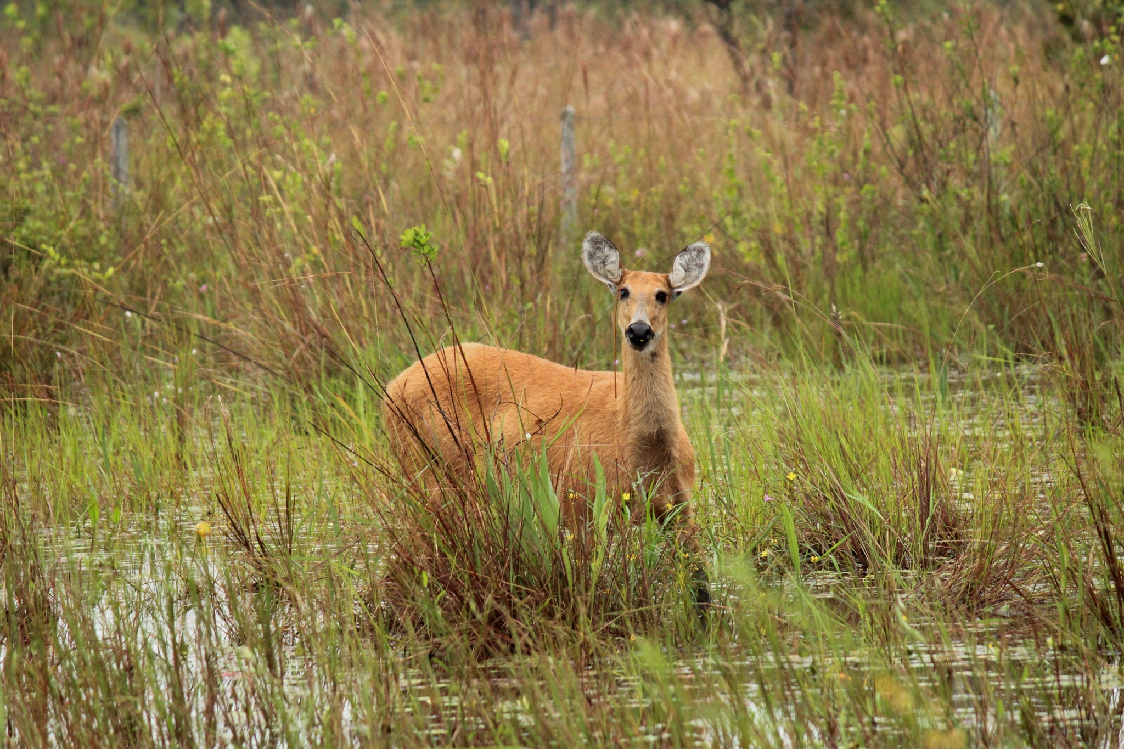
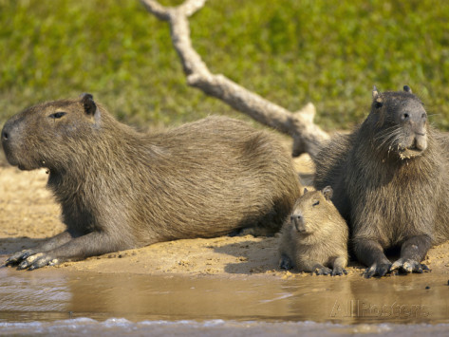
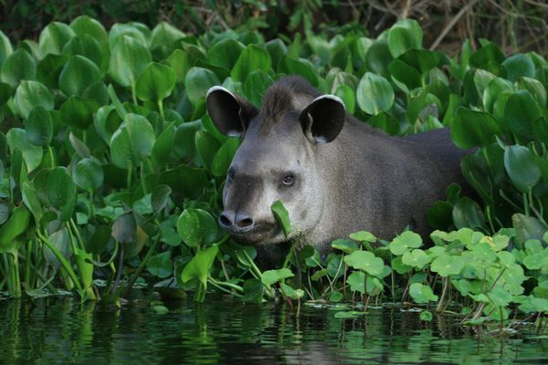
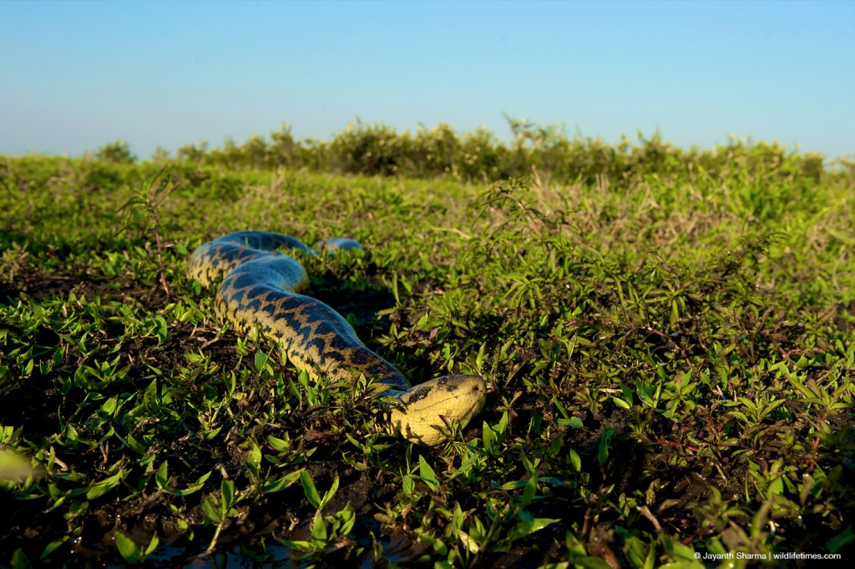
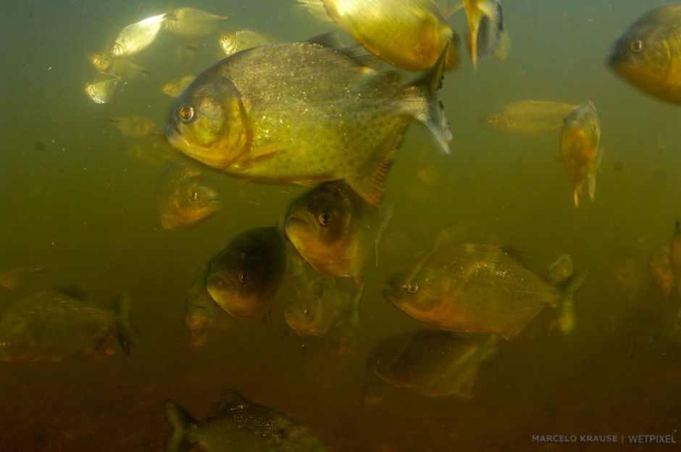
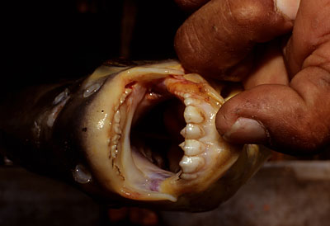
Notes:
Some of 405 fish species have been described – many are tolerant of low oxygen level. Rivers are also home to large populations of piranhas. When the fish migrate for food or spawning thay can change the water silver.
Snakes and tortoise are presented, but only anaconda is abundant.
Total of 657 bird species have been recorded from the Pantanal.
Herbivorous mammals include capybara, tapir and marsh deer.
Predators include jaguar, wild dogs and several smal cats.
Toothcarp

Slide 20
Human impact
dams
increase d production of game fish
exotic species
water pollution
low pH due to acid rains
eutrophication
decrease in dissolved oxygen content
removal of riverside plants – reduction of shade and cover for life in stream
fishing, birdwatching – disturbance of nesting birds
Notes:
It may be imposible to find a large or floodplain river that human activities have not altered. Human use is significant, the physical structure of the stream environment has been altered as has water chemistry and the composition of river life.
Dams have effect bothe upstream and downstream. Above the dam the river is transformed into lake and river organisms are replaced by those of still waters. Dam creates barrier to the movement of river organisms. Downstream the seasonal cycle of low and high water is altered as water is releases to serve human purposes, such as electric power generation, flood control, or irrgation. Colder/warmer water gets into downstream parts.

Slide 21
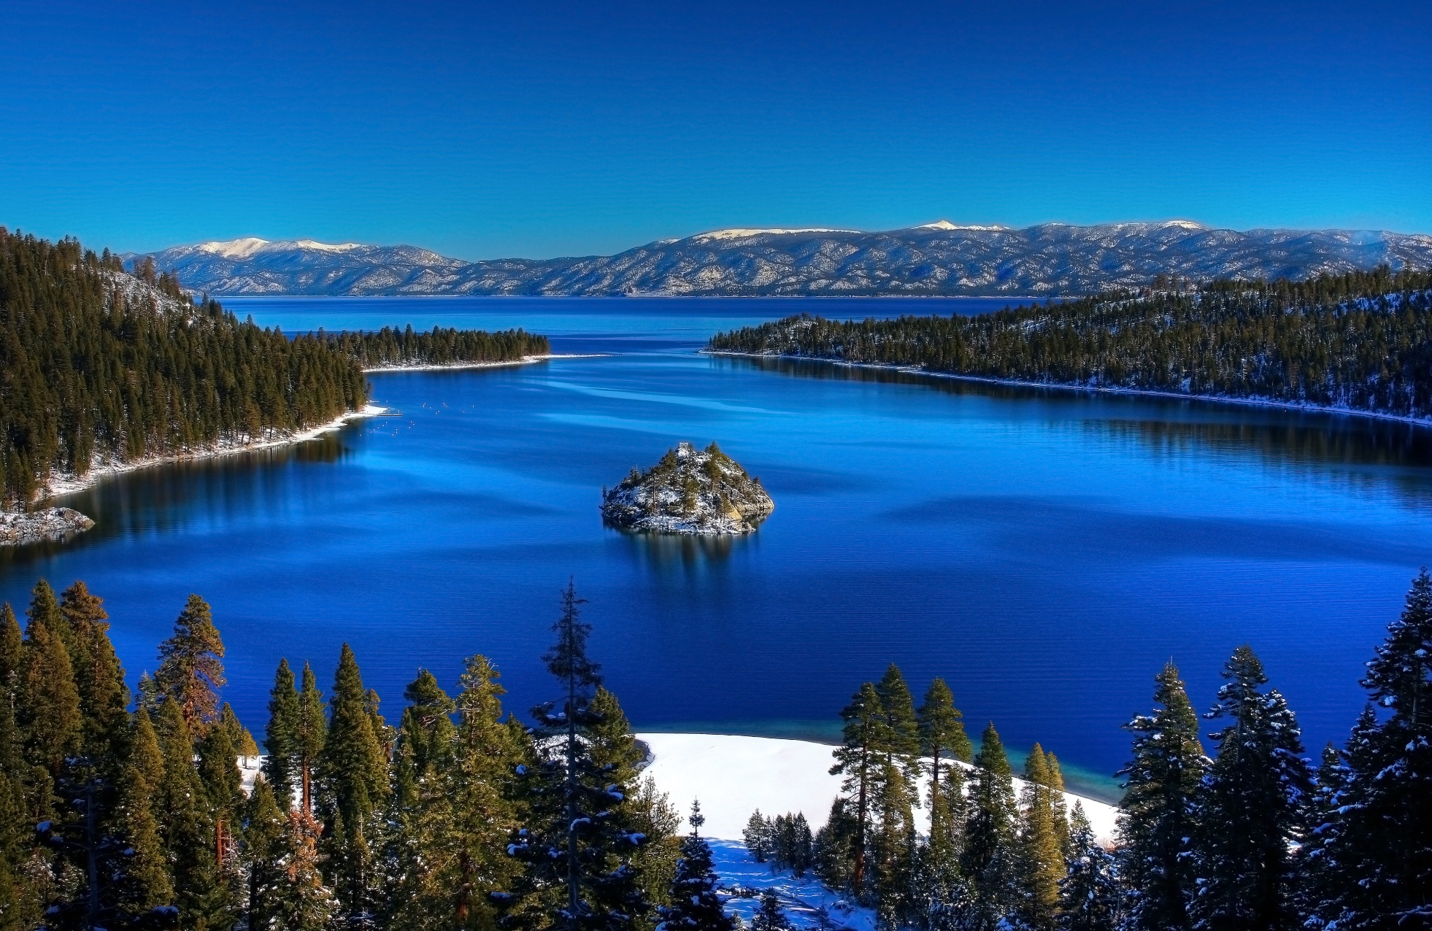
Lakes and ponds
Notes:
Lake is any water filled depression on land that is cut off from inflow of ocean water. Lake account for 0,009% of water on Earth, but they occur in great variety. Lakes are found in a variety of climate regions. Age affects the numbers and uniqueness of life-forms inhabiting a lake, but the overall nature of a particular lake is strongly controlled by its water chemistry – a product of geology and climate.

Slide 22
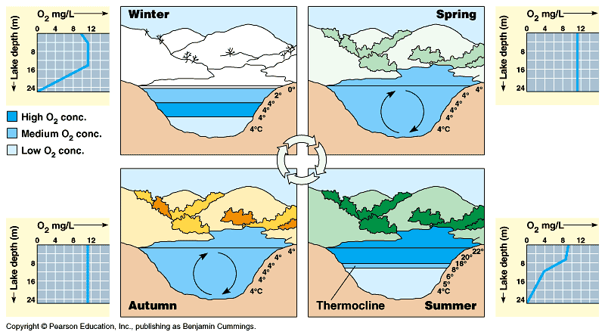
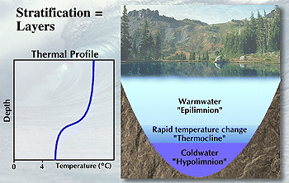
The lake environment
Notes:
Not all lakes mix twice a year. Shallow lakes may mix completely whenever the wind blows. Some lakes mix only very rarely. The Dead sea, the saltiest lake on Earth mix based on amount of freshwater coming from below. When there is enough freshwater it mixes and it is in average every 300 years. On the other side the Lake George in Uganda is deep 2,5m and mixes every night while during the day it is stratified.
In the tropics, where there are no significant temperature changes through the year mixing is infrequent. In some cases, killing of people/animals due to mixing – in hypolimnion are gasses from decomposition in high concentrations.
Oxygen and CO2 are better soluble in cold water.

Slide 23
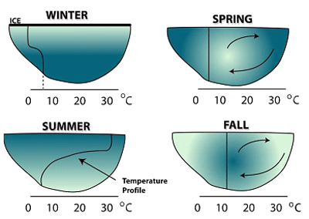
Notes:
In the open water of a lake, phytoplankton live in the epilimnion, the depth of which corresponds to the depth at which most light penetrates and so it is called the euphotic zone.

Slide 24
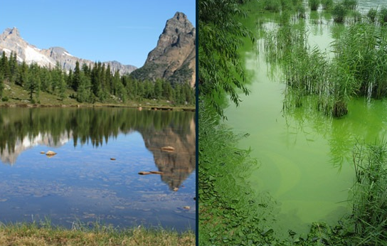
Oligotrophic lakes
few nutrients
clear water
few phytoplankters
low density of animal life
Mesotrophic lakes
enough nutrients
dissolved gasses
diverse community of animals
Dystrophic lakes
black or brown water from a high content of humic or tannic acids
very acidic and low in carbonates
distinctive community of acid tolerant aquatic plants
Eutrophic lakes
nutrients rich
greenish – abundance of phytoplankters
shallow – accumulation of sediments
low concentrations of oxygen
large number of individuals in a few species

Slide 25
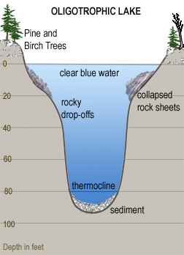
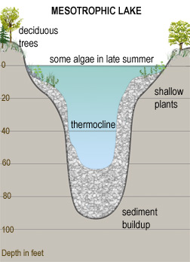
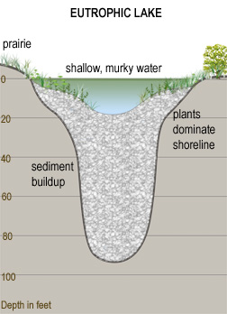
Succession

Slide 26
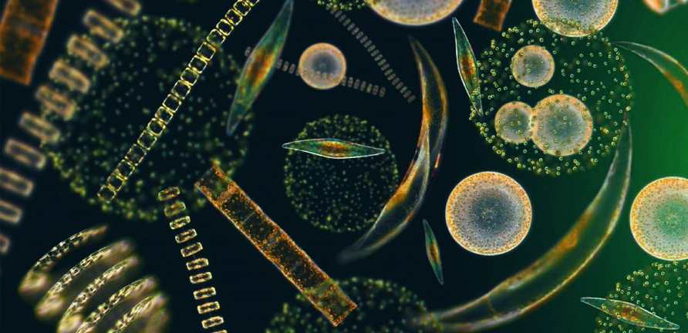
Phytoplankton
cyanobacteria and different kind of algae
actual amounts and kinds vary according to climate, season, water chemistry, nutrient levels and animals that feed upon them
primary producers
Notes:
Diatoms – silica in cell walls. If there is lack of silica in the water the population crashes.
Cyanobacteria tolerate decreased concentration of oxygen and increased concentration of nitrogen. In higher amounts during late summer and autumn.

Slide 27
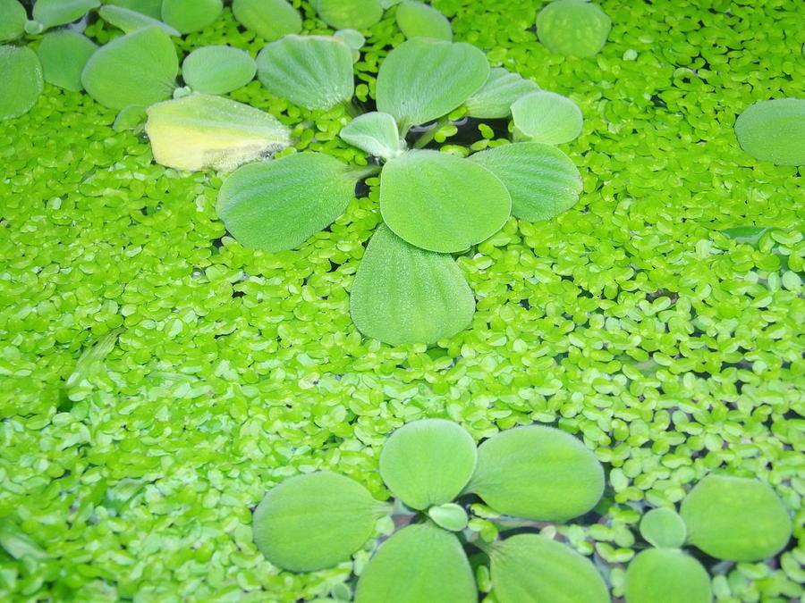
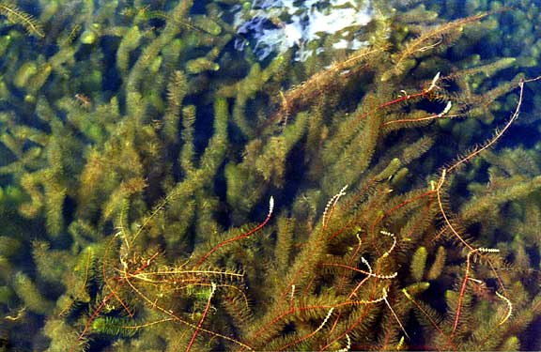
Plant life
The larger plants in a lake are primarily associated with the littoral zone of shalow water close to shore
free-floating plants have leaves and flowers exposed to air
other floaters – most of the plant is submerged and only flower above water
most floaters are attached to the bottom
Notes:
Free-floating plants – water lettuce, water hyacinth, duckweed
Other floaters - milfoils

Slide 28
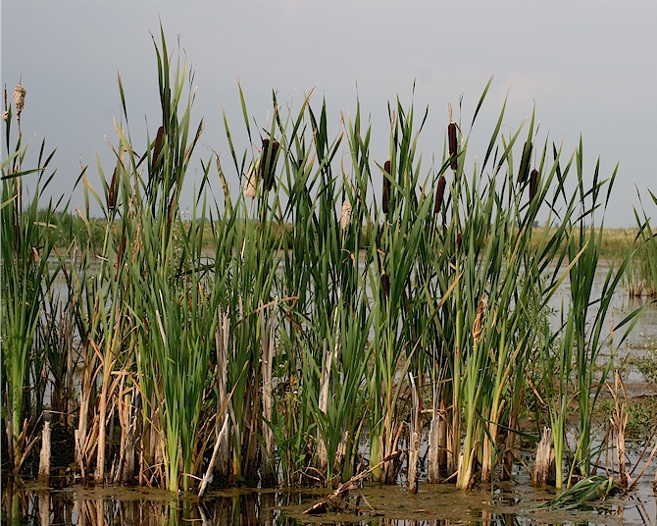
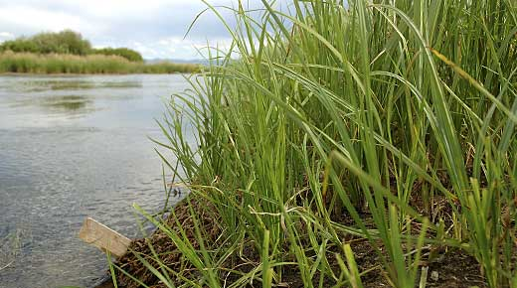
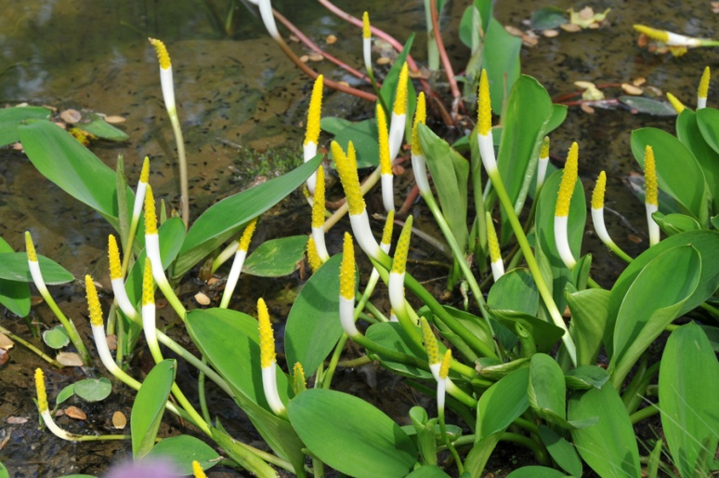
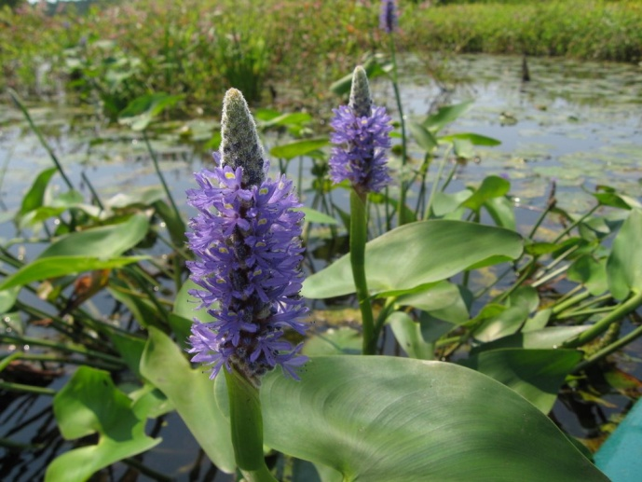
emergents confined to the outer fringe of the lake
Notes:
Cattails, reeds, sedges, golden club, pickerelweed

Slide 29
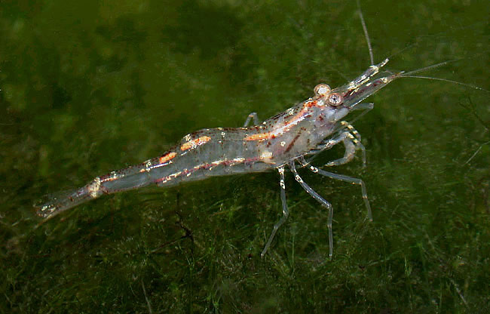
Animal life
zooplankton
freshwater sponges
flatworms, annelid worms, oligochaete worms
gastropods and bivalves
insects
fish species
amphibians
reptiles
birds
mammals
Notes:
Zooplankton – rotifers (filter feeders) and crustaceans of the order Cladocera and Copepoda. Cladocerans – e.g. water fleas. Copepods – small particle feeders – e.g. Cyclops.
Other crustaceans – opossum shrimp, water louse, freshwater shrimp (Gammarus) and crayfish

Slide 30
Notes:
Sponges - Spongilla lacustris, Hydra viridis
Flatworms (planaria), annelid worms (leeches – have suckers at either end on their ventral surface to attach to prey. They feed on blood, and sometimes consume prey), oligochaete worms (deposit feeders. They build tube like burrows in soft sediments on a lake bottom)

Slide 31
Notes:
Gastropods and bivalves. Snails scrape algae and detritus from rock and other surfaces. Bivalves include large unionid mussels – Anodonta, Unio and small clams – pea clam. Both filter particles out of water. Bivalves live in soft sediments, while gastropods are associated with hard surfaces.
Most insects occur as larvae and are important components of the benthic community because they provide food for many fish. Adult are important predators on the surface of lakes – damselflies, dragonflies and true bugs – pondskaters, water boatman

Slide 32
Notes:
Amphibians – frogs, toads
Reptiles – snakes, turtles, alligators and caiman
Mammals – beaver, muskrat and moose – herbivores
- otter, mink, racoon, fish eating bats - carnivores

Slide 34
Large temperate freshwater lakes
Great Lakes of North America
Notes:
They contain 20% of the total freshwater on the surface of Earth and with the waterways that connect them, form the largest freshwater system on planet.
Invasions – alewife, sea lamprey, round goby

Slide 35
Lake Baikal
Notes:
It is the world´s deepest lake and one of only 2 lakes on the planet deeper than 1000m. The maximum depth is 1620m. It is the world´s oldest lake and thus it contains many endemic species. 35% of plants and 65% of animals are endemic. It has no amphibians.

Slide 36
Tropical lakes
Great Lakes of East Africa
Notes:
The tropics have relatively few lakes. Several conditions distinguish tropical lakes from these of the temperate zone. At low and moderate elevations, freezing never occur, but strong seasonality may be experienced as annual fluctuation in water level related to distinct rainy and dry seasons. There is found more species overall.
All 3 lakes are known because of their great variety of cichlid fishes.
Lake Tanganyika is the second deepest and probably the world´s second oldest lake. The greatest depth is 1470m. It has 126 species of cichlid fishes and other 67 fish species where 70% are endemic. It has also 2 species of aquatic snakes – pit viper (swims in the open water and feeds on sardines) and cobra (fishes at night). It has also 60 different species of gastropods where 50% are endemic.
Lake Malawi is the 4th deepest in the world. The biodiversity of fish is great – 245 fish species, most of them are endemic cichlid species.

Slide 37
High-altitude lakes
Lake Titicaca
Notes:
Lake Titicaca is the highest navigable lake, it lies in the 3810 m altitude. The diversity of species is low. There are 2 endemic reed species known as totoras, which are used for famous reed boats on lake Titicaca. The dominant benthic species are mollusks, aquatic insects are of secondary importance. The fish fauna consists of diversified group of endemic species

Slide 38
Saline lakes
Caspian Sea
Notes:
Saline lakes hold 0,008% of Earth´s water. 70% of that is in the Caspian sea, the world´s largest lake in terms of surface area. Salinity varies from 3ppt to more than 300ppt in some hypersaline bodies of water such as Dead Sea. The Dead Sea has 10x the salt concentration of seawater. Lakes with high concentrations of salts support only very simple communities.
Caspian Sea´s phytoplankton is composed of about 450 species. Zoplankton is made by about 100 species. Benthic animals are hghly endemic. It has about 125 fish species. It is very important area for wintering and resting for migratory birds from all over the lands of the former Sovie Union. The only mammal of Caspian Sea is a seal.

Slide 39
Human impacts
irrigation projects
introduced species
overfishing
nutrient enhancement – eutrophication
pollution by pesticides and industrial wastes

