Slide 1
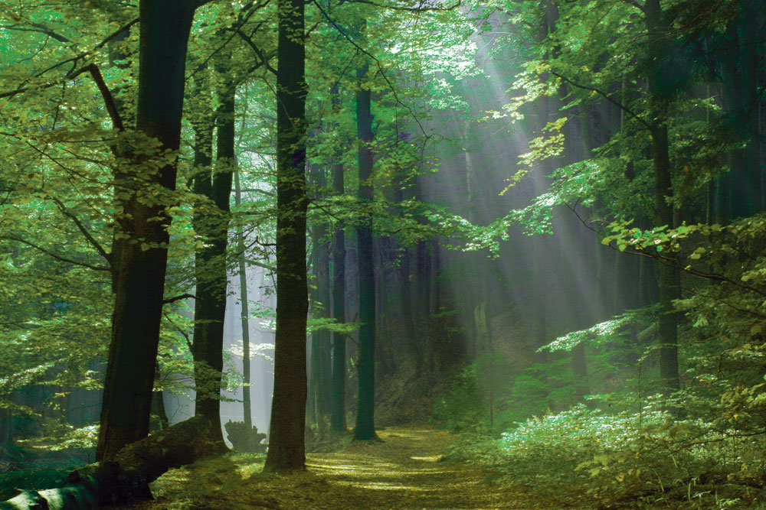
Temperate broadleaf deciduous forests

Slide 2
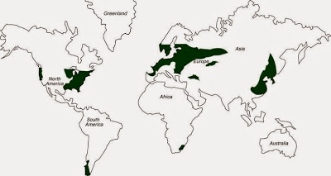
Notes:
Precipitation is evenly distributed throughout the year and average annual precipitation ranges between 750-1250 mm. Winters are cold with at least some snow, summers are warm and hot. The growing season is 6 months or longer. There are 4 distinct seasons – spring, summer, autumn, and winter

Slide 3
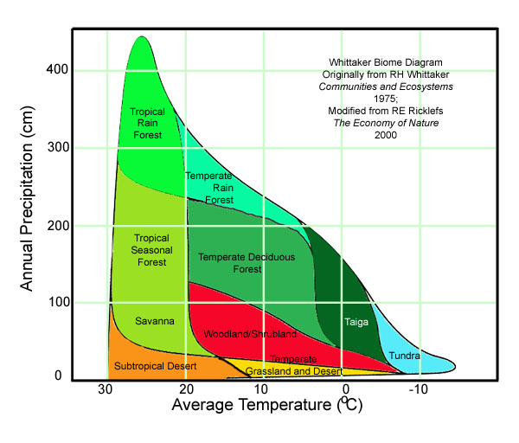

Slide 4
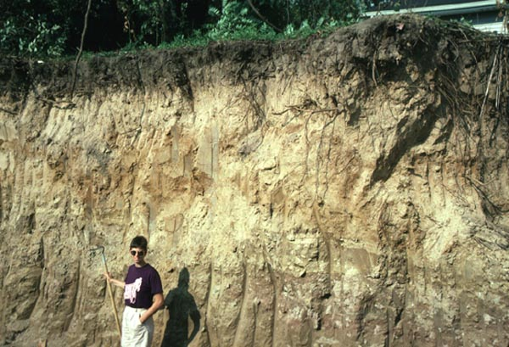
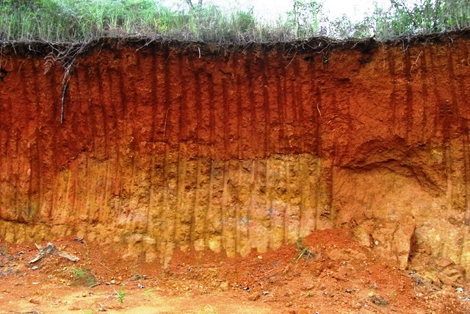
Soils
Alfisols
Ultisols
Notes:
Two types of soils are characteristic, and both are product of podzolization soil-forming process. In cooler areas – alfisols and in warmer areas – ultisols. The organic layer contains nutrient-rich leaf litter that is deposited in autumn but begins to declay in spring – it supports the growth of germinating plants.

Slide 5
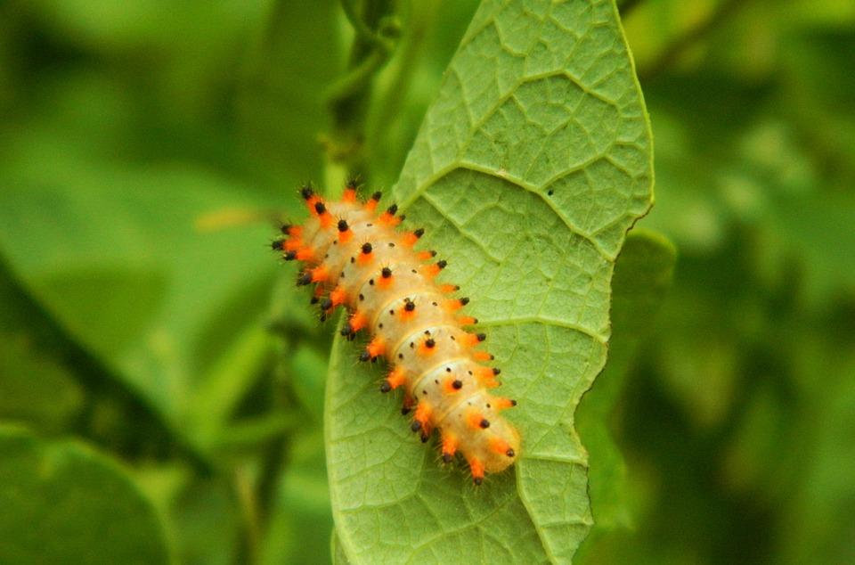
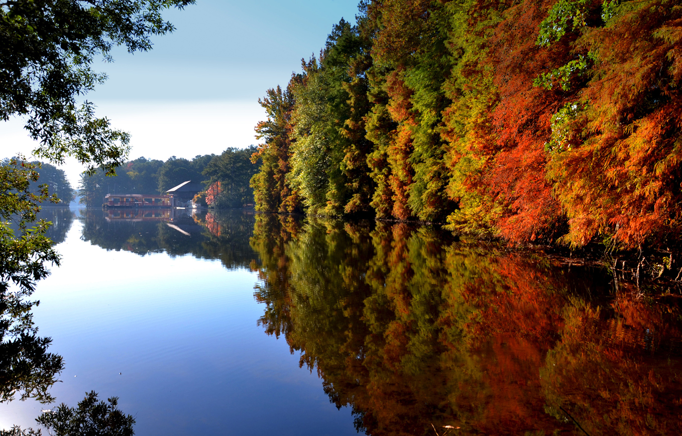
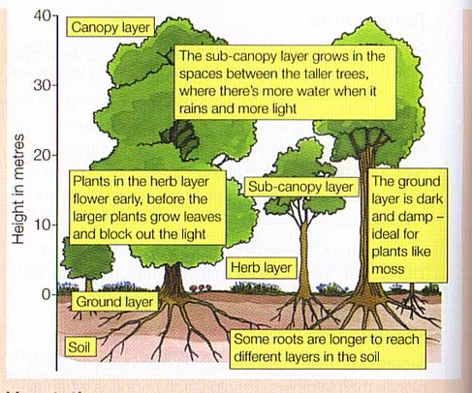
Vegetation
Notes:
Forest has a multilayer structure. The tallest trees form a canopy. Beneath them is a small tree or sampling layer made up by crowns of small trees. Shrub layer, herb layer of perennial forbs. Ground layer of lichens, and moses. The seasonality of hte life processes is one of the key characterstics of the forest. A period of vegetative growth and activity and a distinct dormant period exist.. The most obvios is the turning color of the leaves srom green to yellow, brown, red, orange in autumn. Young leaves contain the highest amount of nitrogen, phosphorus and potassium compounds, so many insects coordinate the hatching of their larvae to this springtime abundance of nutrients. Migratory birds time their arrival to the exposion of insects.

Slide 6
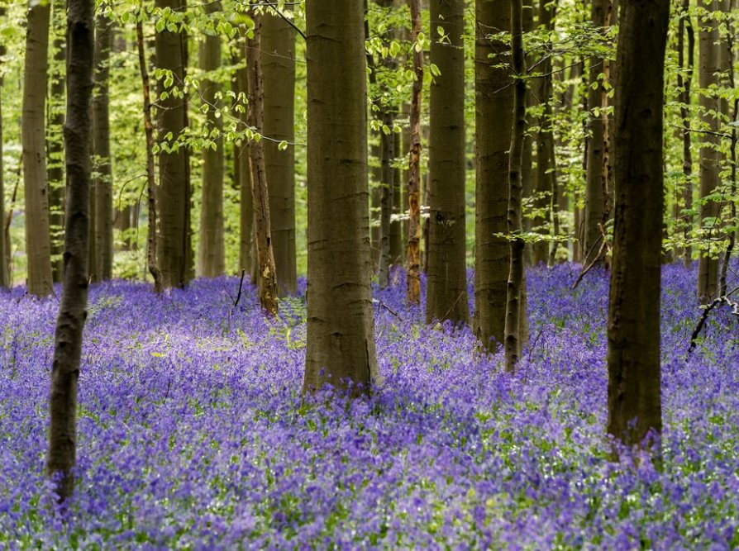
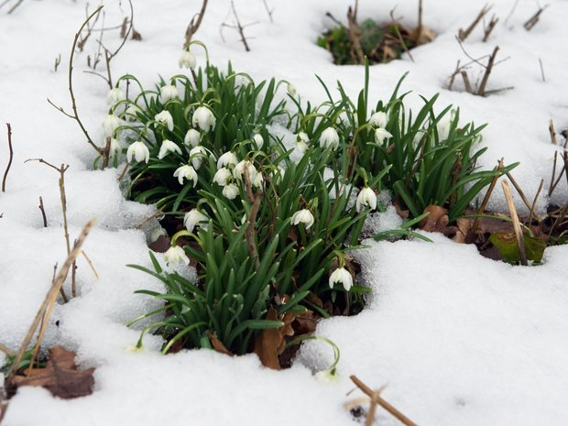
Notes:
Spring greenup begins at the forest floor with a flush of flowering perennial forbs. Few can bloom while a snow is still on the ground (the heat generated by the flower melts the overlying snow). Perennials complete their growth when they can take advantage of the short period when ground temeperatures are moderate and canopy trees have no leaves. The shrub layer responds early in the spring too. Finally, the leaves on the canopy trees expand and shade the forest below, which slows the activity of smaller plants.

Slide 7
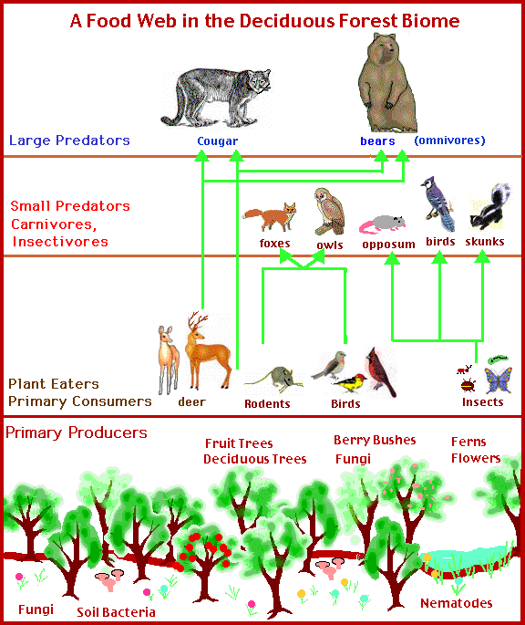
Animal life
Notes:
There is a great variety of habitats and food resources for invertebrates and small vertebrates. Many kinds of insects, amphibians, reptiles. The abundance of insects suports many insect-eating birds. Among mammals – rodents, bats and insectivores are the most diverse. From predators are presented foxes, wolves and cougars. Animals have few patterns connected with seasonal rhythm, insects activity and plant productivity. The most common is timing of the reproduction season with the greatest abundance of food. Hibernation and migration are adaptions to cold and scarcity of food.

Slide 8
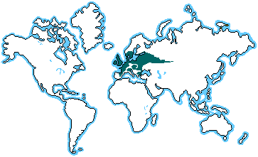
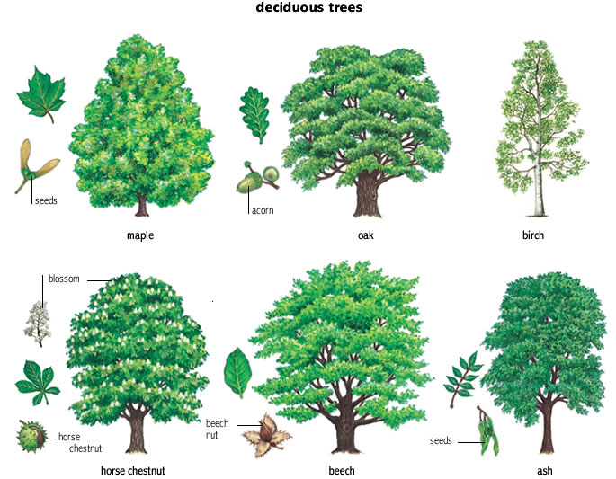
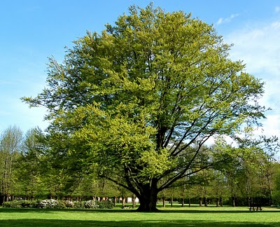
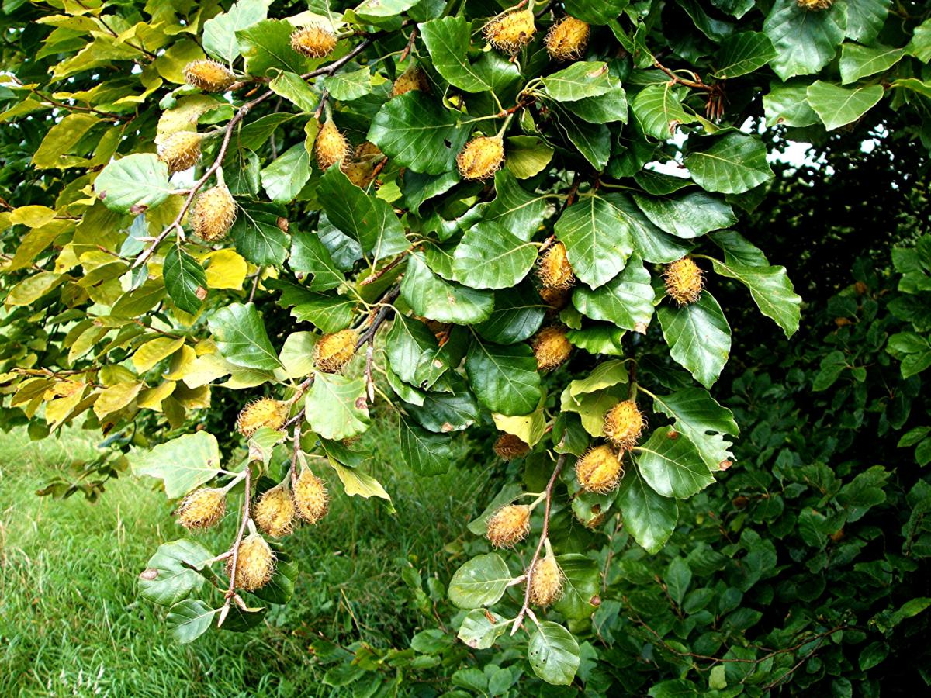
Europe
Notes:
These forests suffer the major extinction during Pleistocene glacial periods and today are the least diverse of the three major northern hemisphere expressions of the biome. Dominant tree is European beech (Fagus sylvaticus). It is accompanied mainly by oaks. Tree communities are distributed along environmental gradients created by the climatic trend from maritime climate with relatively mild winters and cool summers in the west, to continental climates with cold winters and great annual temperature range in the east. Latitudinal position plays also a role in climatic differentiation, and broad north-south differences in forest composition are apparent.
Another trees which can be found in the deciduous forests are ash (jaseň), alder (jelša), lime (lipa), maple (javor), aspen (osika), elms (brest) and spruce (smrek)

Slide 9
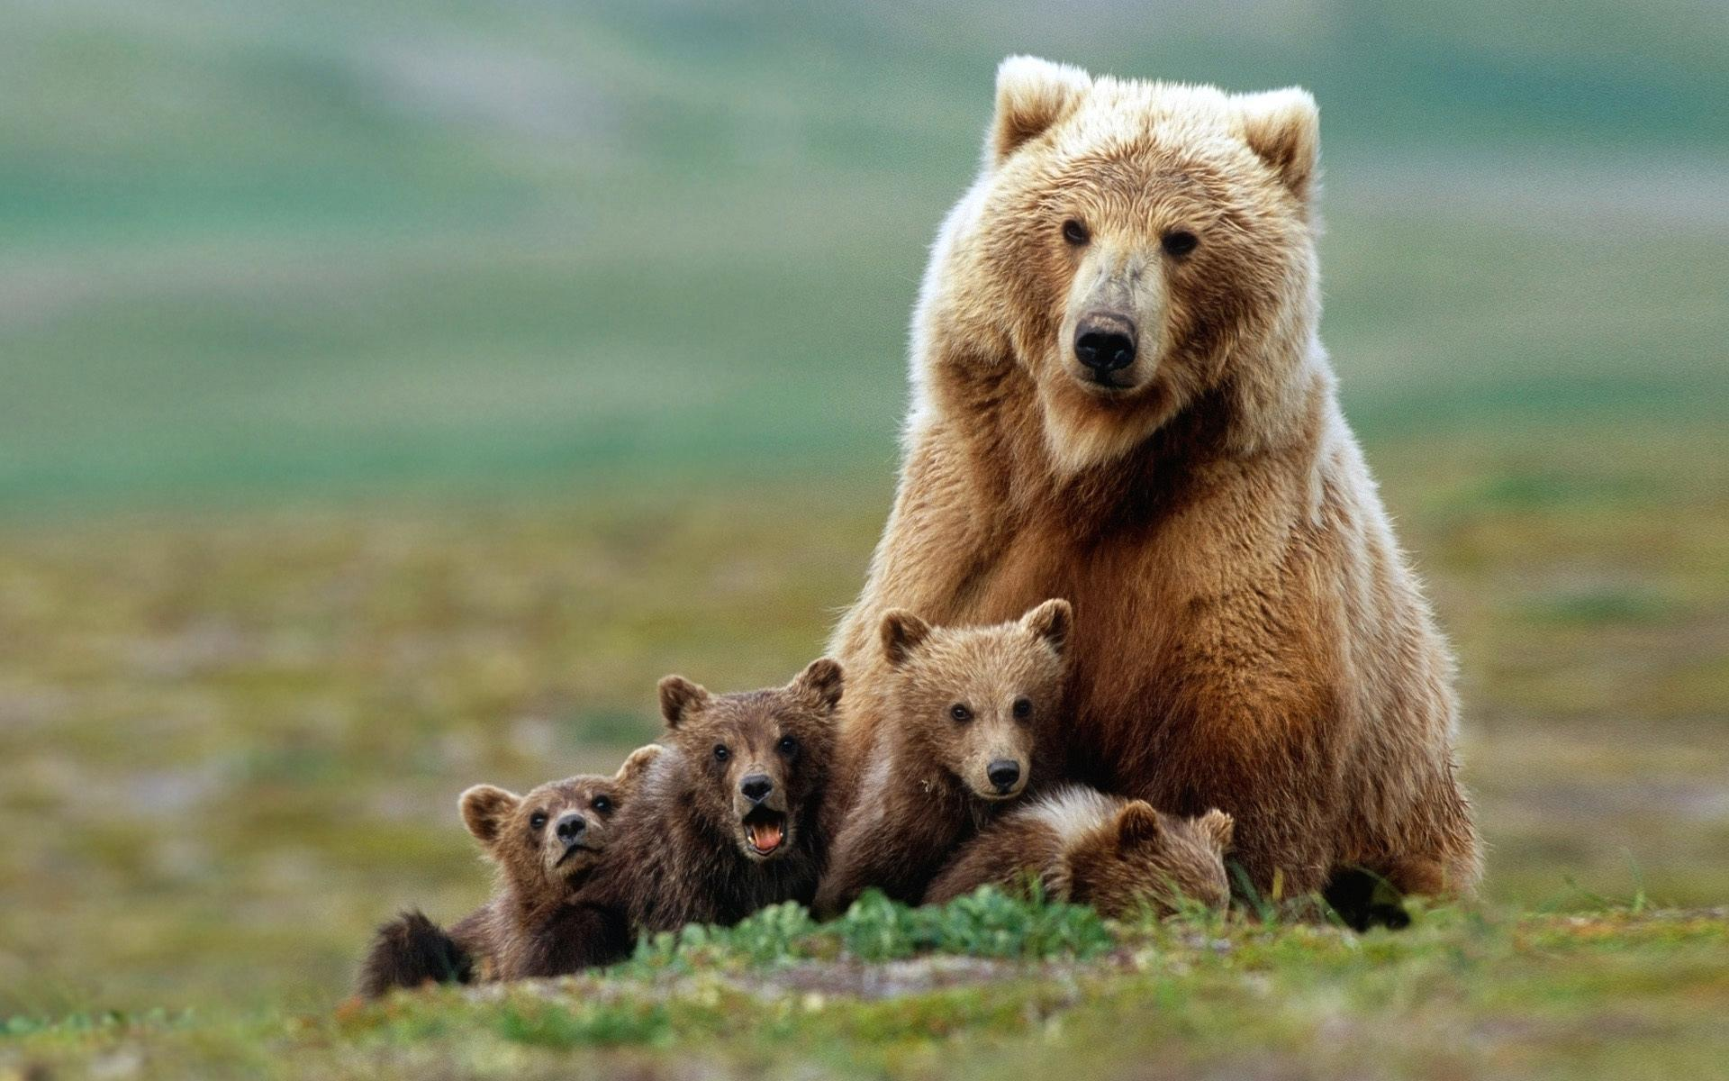
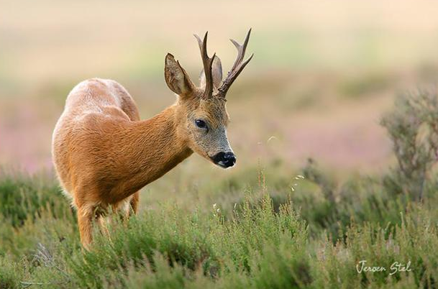
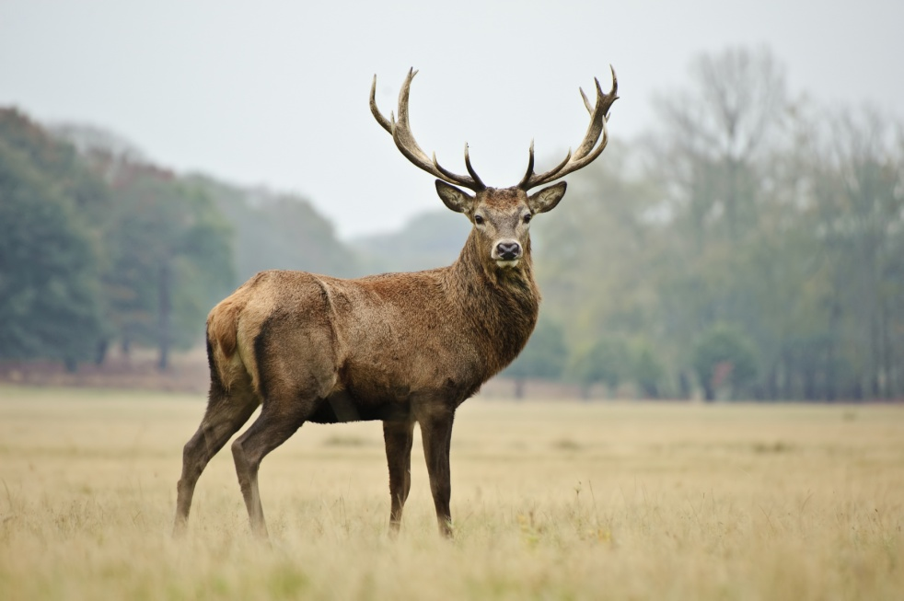
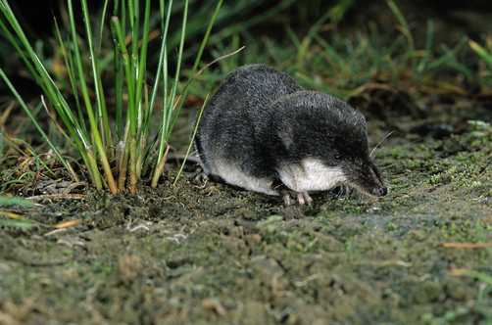
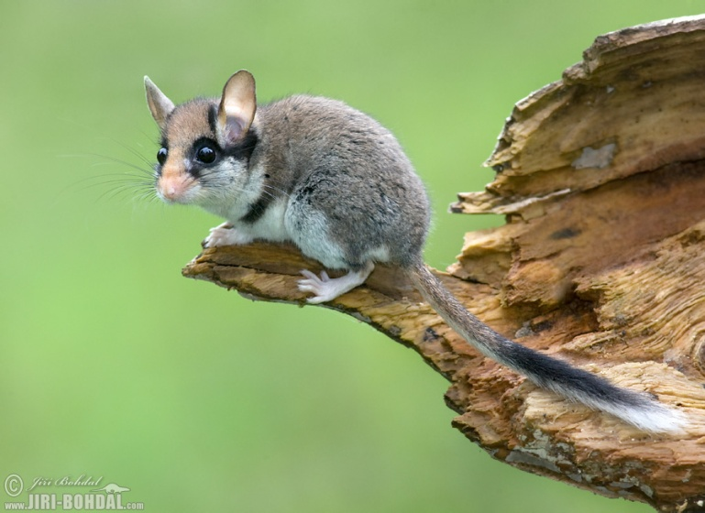
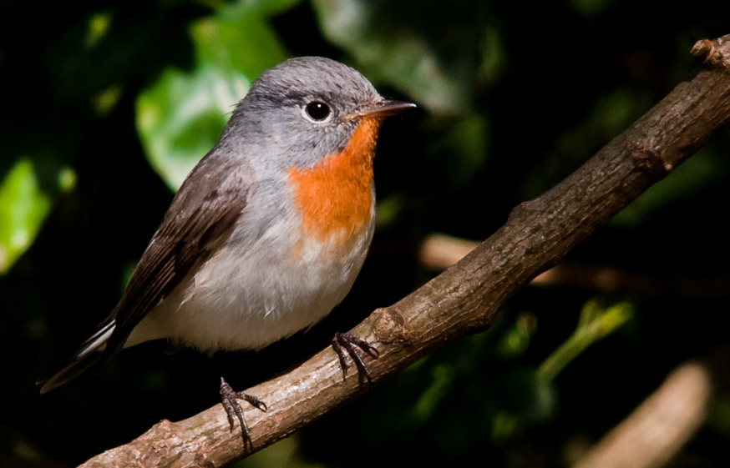
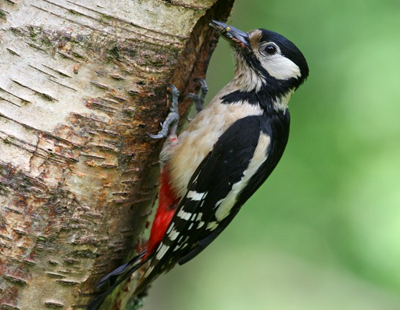
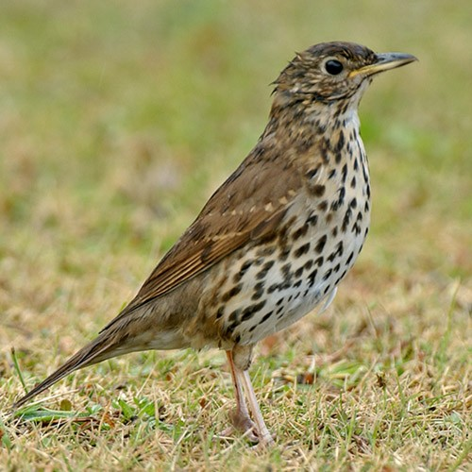
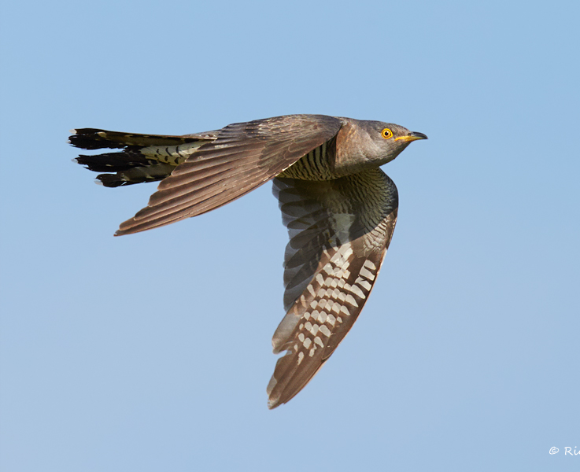
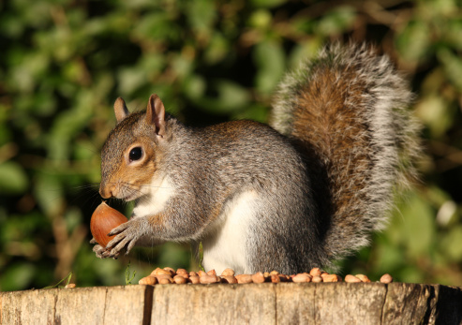
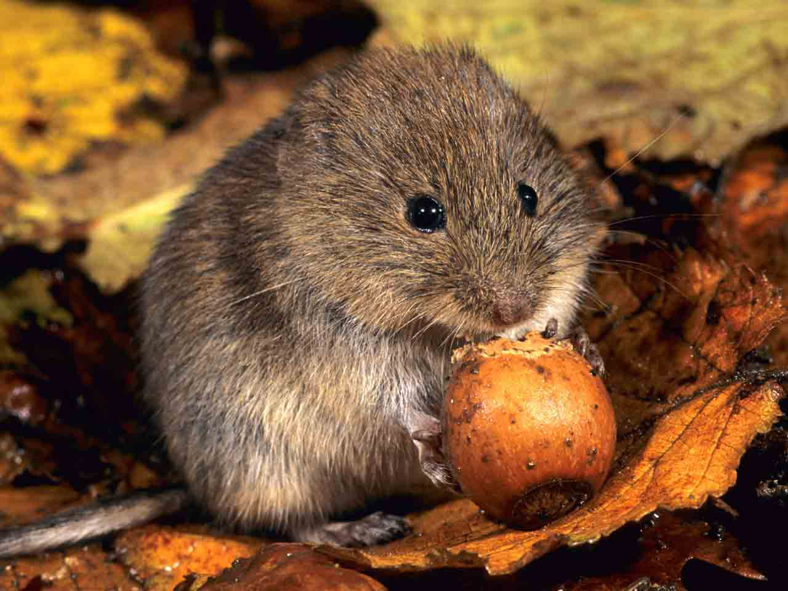
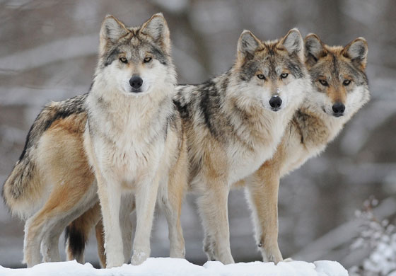
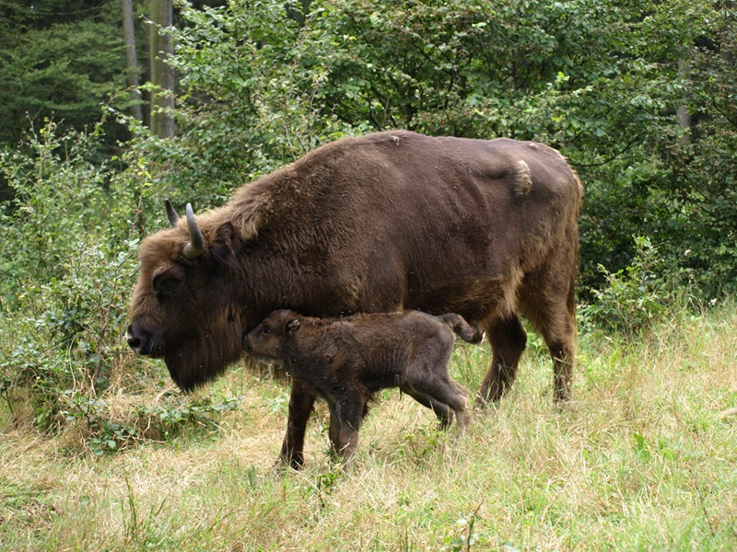
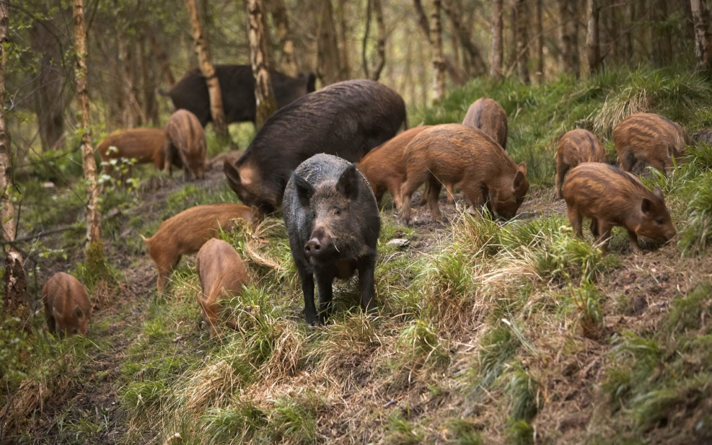
Notes:
Birds – woodpeckers, thrushes (spevavce), flycatchers, cockoo
Small mammals – rodents – garden dormouse, european shrew, bank vole (hrdziak lesný)
Large mammals - roe deer, red deer, wisent, wild pig
Predators – bear, wolf

Slide 10
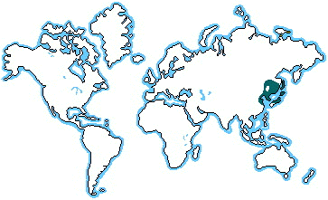
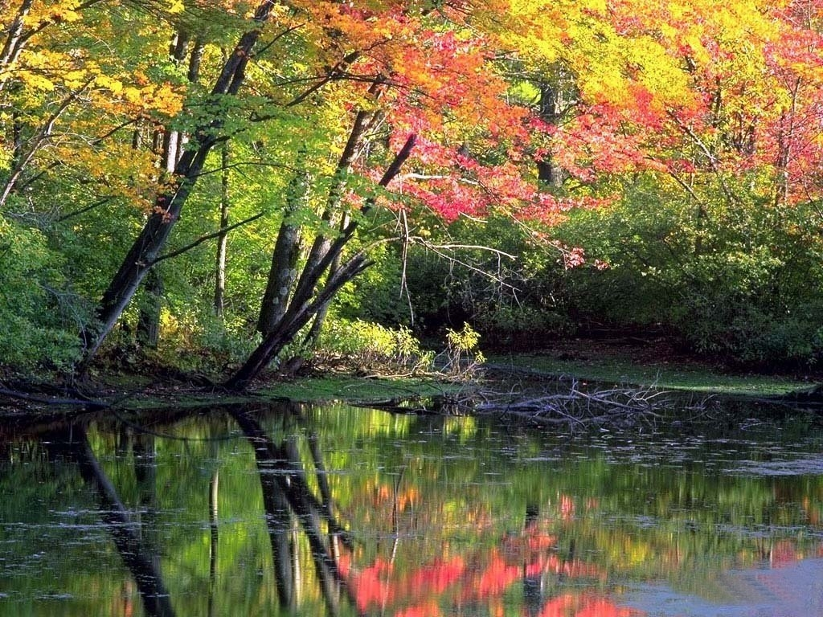
East Asia
Notes:
It stayed largely untouched by glaciers during the Pleistocene. This has resulted in the preservation of several older lineages of plants, some are relicts of the Terciary Period (60mil. Years ago) – ginko and dawn redwood. Many forests have been destroyed by intensive agriculture (like in other continents).

Slide 11
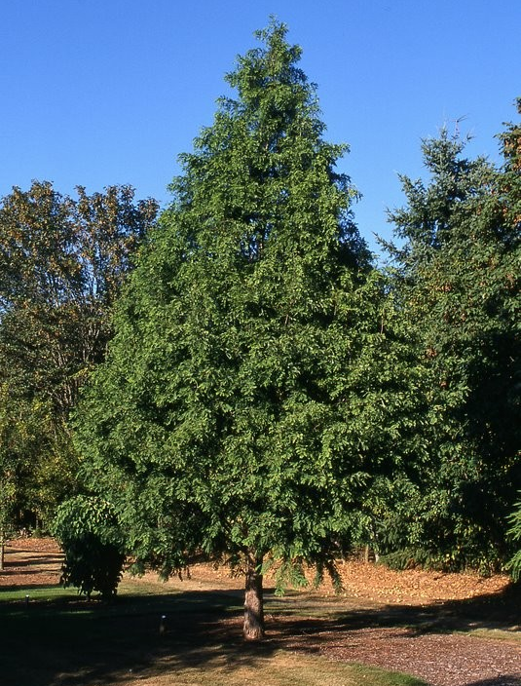
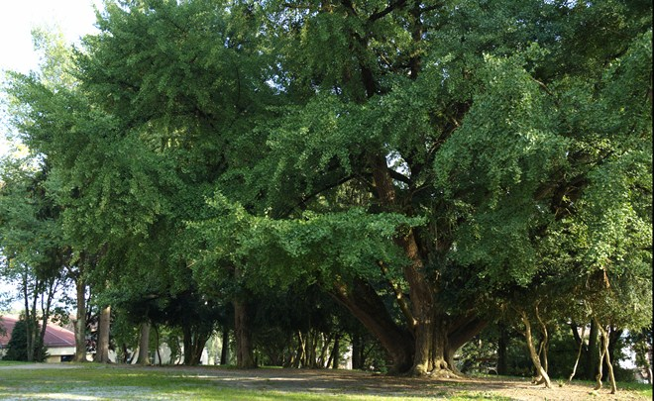
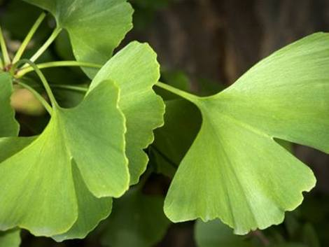
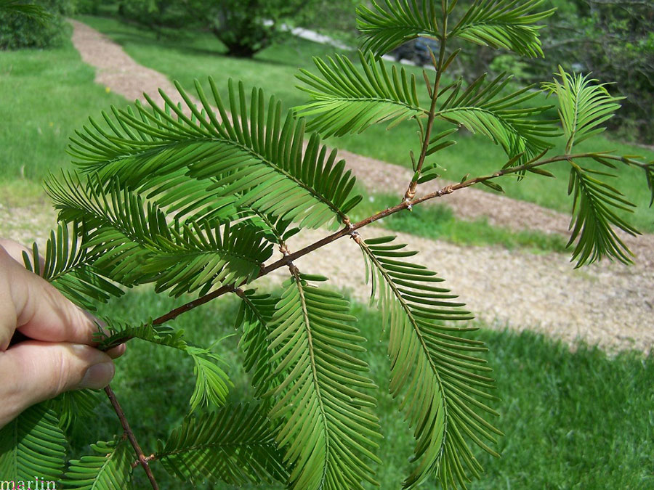
Notes:
The ritchest type of forest is along Yangtze Valley under a very hot and humid climate in the summer, but cold and dry in the winter. There is predominance of oaksjoined by chestnut, sweetgum as well as ginko and dawn redwood. Animal life is quite unknown. Birds and mammals are similar as in European deciduous forest.

Slide 12
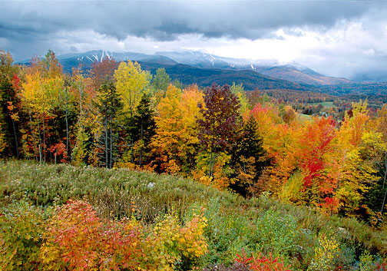
North America
Notes:
Long growing season and nutrient poor soils. There were identified 9 different forest regionsthat make up regional mosaic.

Slide 13
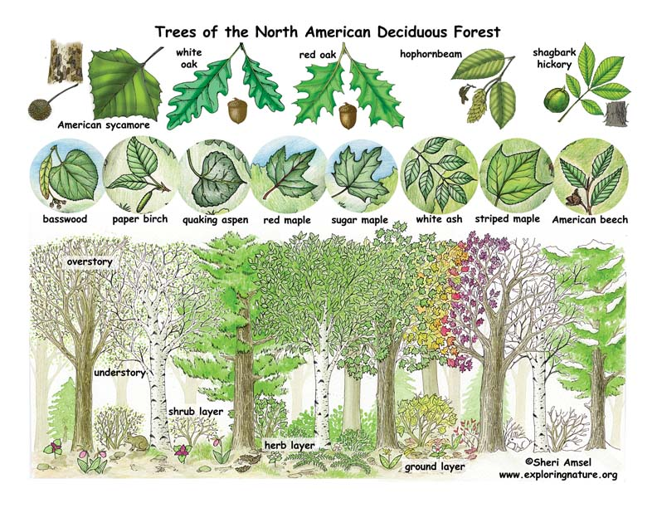
Notes:
Trees are variable in the 9 forest types mentioned. But the main kinds of trees are at the picture. In higher altitudes even conifers can occur – mostly various pines (Pinus sp.) and eastern hemlock (Tsuga canadensis).

Slide 14
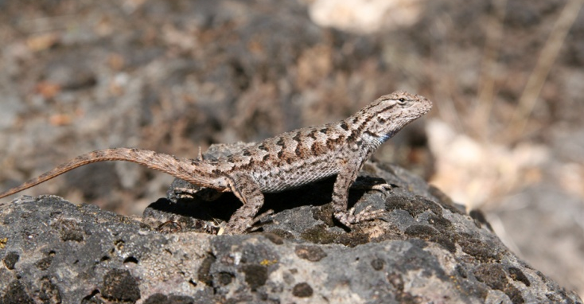
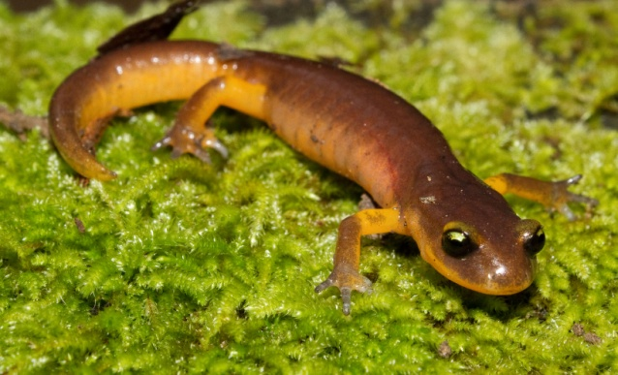
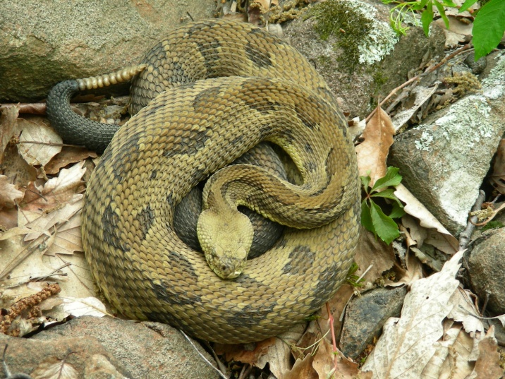
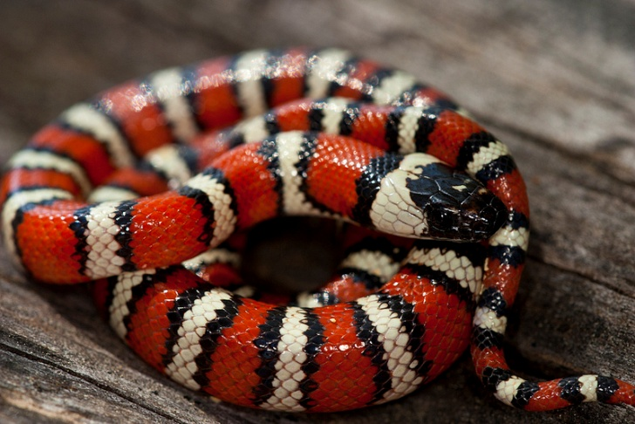
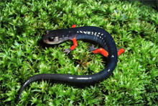
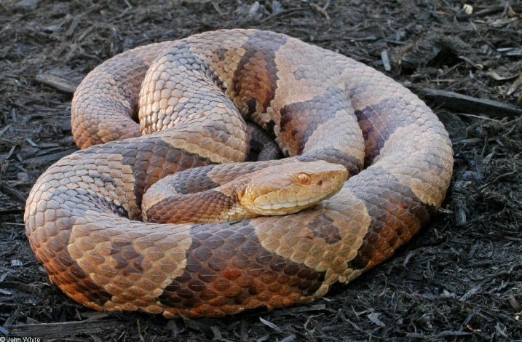
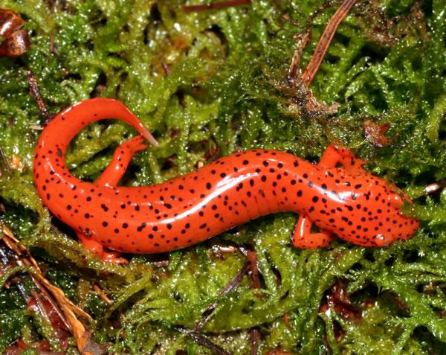
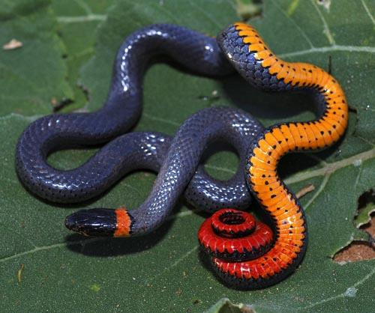
Notes:
Amphibians are well represented. Of particular note are the lungless salamanders (Plethodontidae) which reach their highest diversity in the southern Appalachians. Some 30 kinds are endemic to the Southern Appalachians.
There is 11 kinds of lizards, and the widespread is fence lizard. Many snakes occur, mostly members of family Colubridae, but venomous vipers also occur – timber rattlesnake, coperhead.

Slide 15
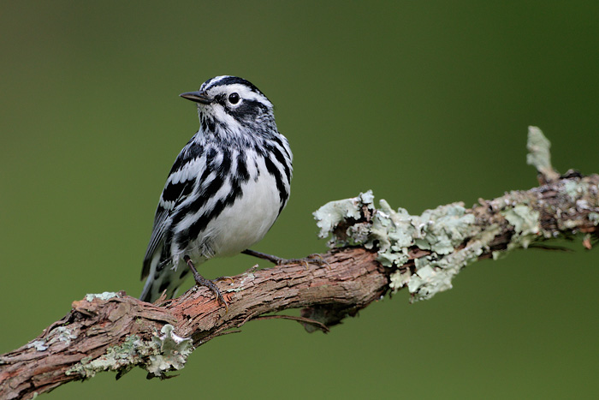
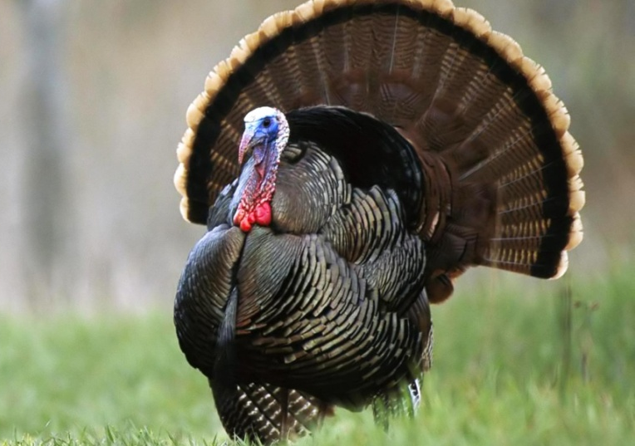
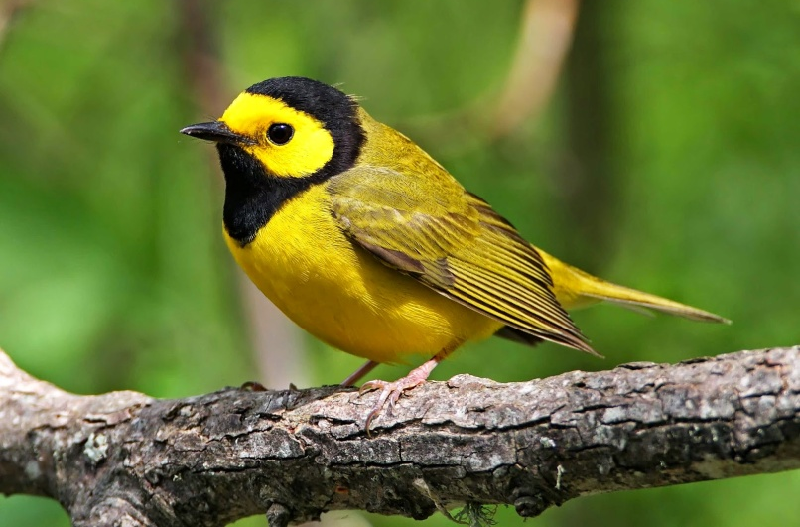
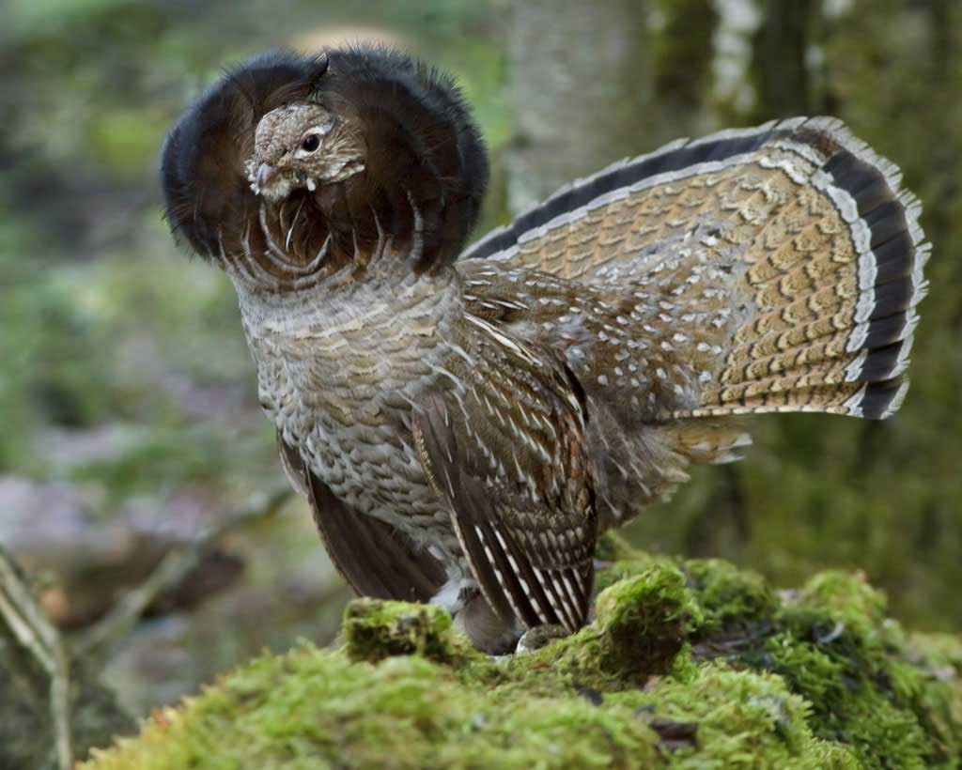
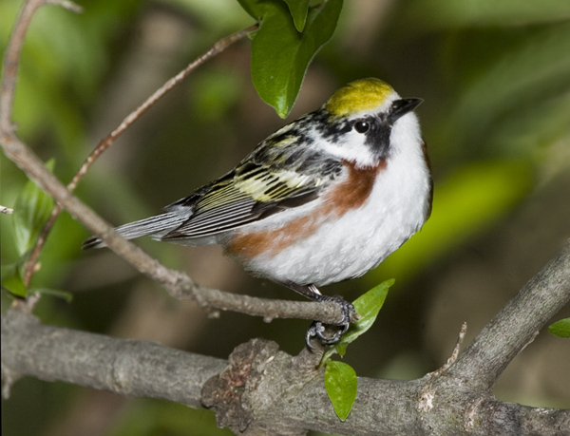
Notes:
Birds are particulary diverse in the mature forests. A large proportion are migratory insect eaters. They winter south of the US in Central and South America. Typical are birds from wood warbler group – Black and white warbler, Hooded warbler, chestnut-sided warbler
Turkey, ruffed grouse, great horned owl

Slide 16
Notes:
The most abundant mammal over much of the region is perharps the short-tailed shrew. Rodents – grey squirrel, eastern chipmunk.
Omnivors – striped skunk, racoon, black bear
Small carnivores – long-tailed weasel, red fox, bob cat
Large carnivores – cougar, wolf, coyote

Slide 17
Notes:
Large carnivores – cougar, wolf, coyote

Slide 18
Human impact
deforestation
hunting
agriculture
increased acidity of the soil – industry
acid rains – destruction of leaves/trees
invasive organisms
Notes:
Deforestation for agricultural soil, but also for constructions, ship building, ... Only areas that survived (means have old trees and former structure of the ecosystem) are too steep, too wet, or too nutrient poor.
Once the trees die, the sunlight can penetrate deeper in the forest. This changes humidity of the earth what endangeres frogs and salamanders and the regeneration of the canopy trees.
Invasive organisms – gypsy moth, chestnut blight

