Slide 1
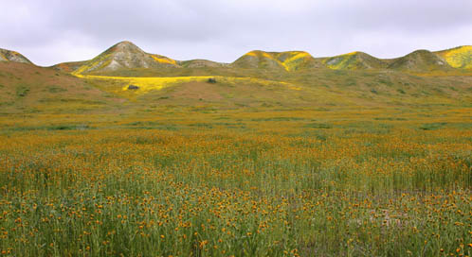
Grasslands
Notes:
In the midlaitudes, natural grasslands are found in the semiarid interiors of North America and Eurasia and in the rainshadow situations in South America and southern Africa

Slide 2
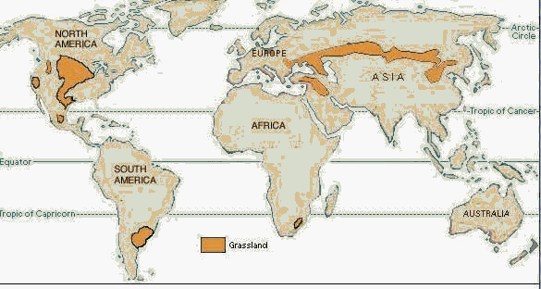
Prairies
Steppes
Pampas
Veld

Slide 3
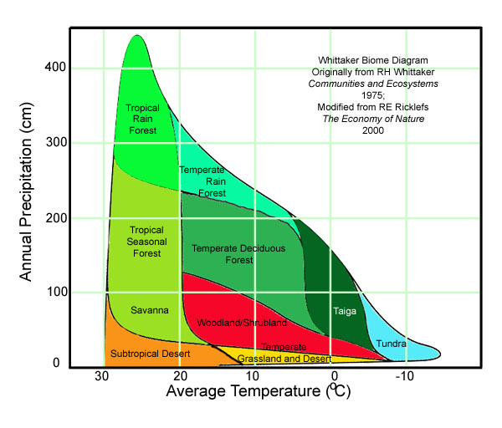

Slide 4
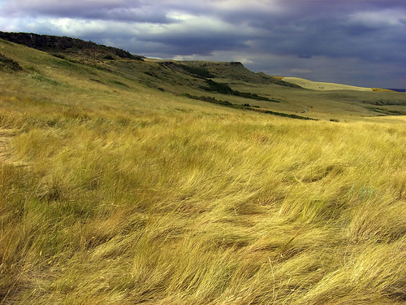
Climate
semiarid continental climates
250 – 750 mm precipitation annually
cold winters and hot summers
wide daily range in temperatures
Notes:
Seasonal pattern of precipitation differ from region to region

Slide 5
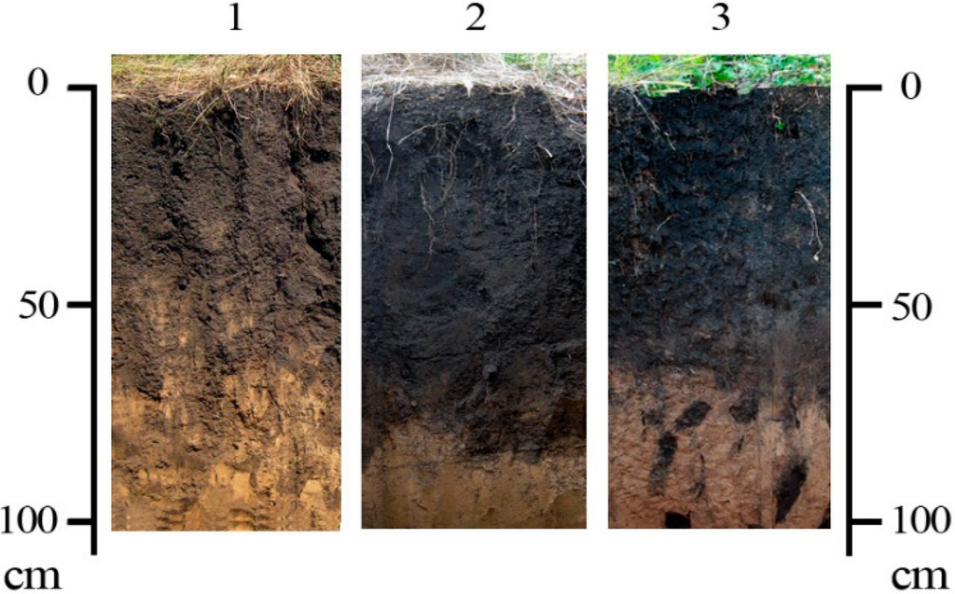
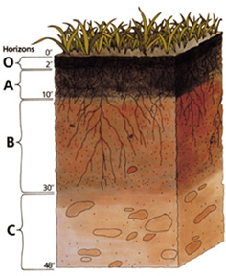
Soils
mollisoils
range is from very black types to lighter brown ones
chernozems
chestnut-colored soils
Notes:
Soils are among the most fertile on earth. They are deep, high in disoolved nutrients, and high in organic matter. The humus or organic material in the soil that facilitates the exchange of mineral nutrients between soil and plant root derives from the annual dying of aerial portions of the grasses and forbs of the grasslands and from continual dying and decay of their roots, which in the moister areas may estend to depths of 3,5m

Slide 6
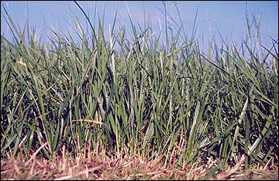
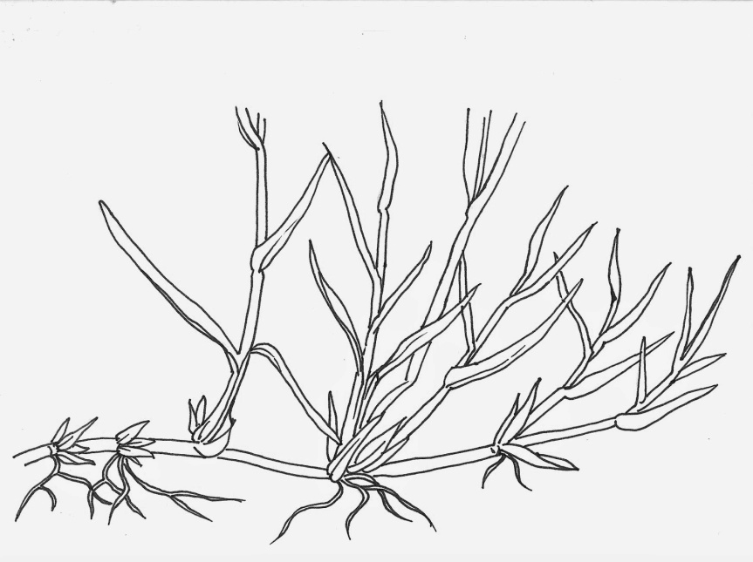
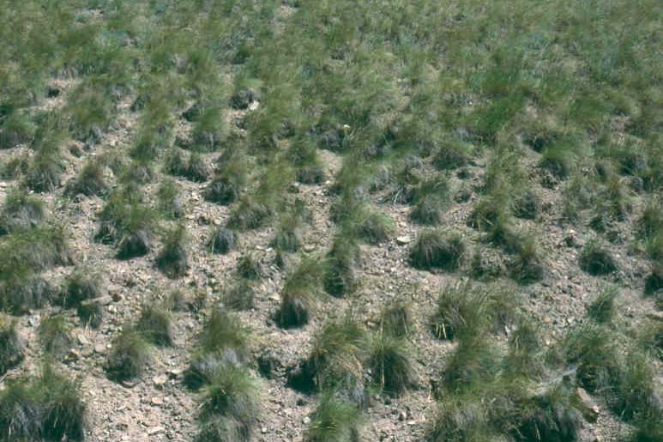
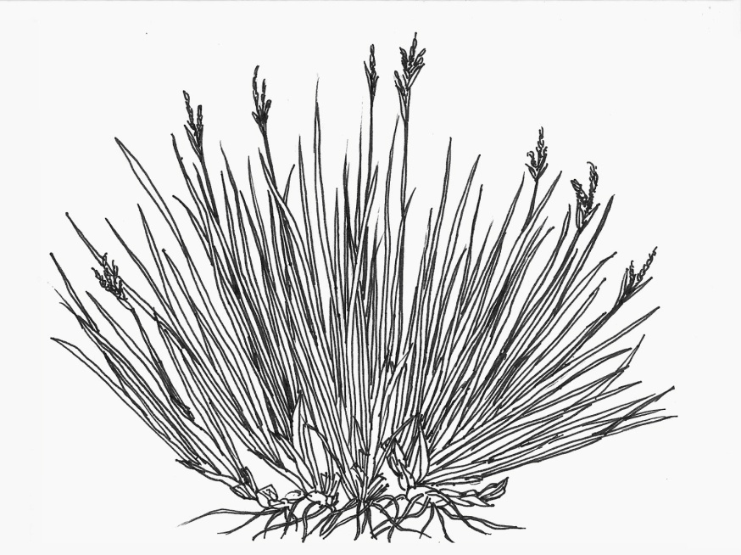
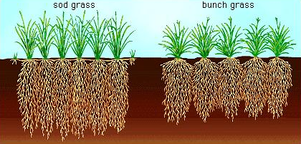
Vegetation
perennial grasses
well adapted against fire, or grazing by large mammals
2 growth-forms of grass
Sod grasses
Bunch grasses
Notes:
Narrow leafy shoots are heldupright to reduce heating in summer. Large fibrous toot systems effectively trap moisture and nutrients from the upper horizons of the soil, and the growth buds are at or below the surface, where they are protected from the dires that sweep through canopy and from grazing animals.
Sod grasses reproduces vegetatively by lateral buds or rhizomes.
Bunch grasses grow as individual clumps of tillers around a central stem and reproduce by seeds.

Slide 7
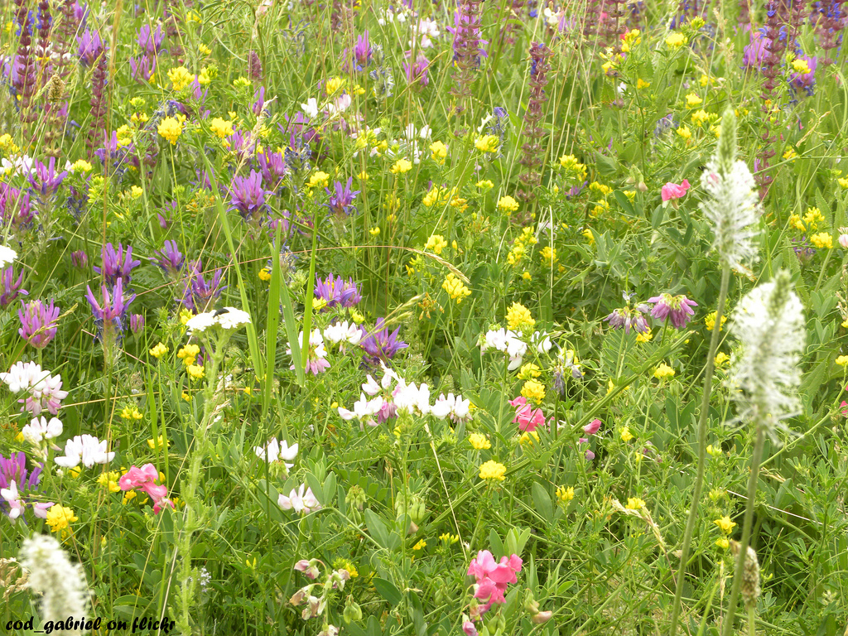
C3 and C4 plants
C4 associated with regions with hot summers
perennial forbs bloom in spring and summer
Notes:
C4 called as well as warm-season grasses beacuse they don´t grow until early summer. Peak growth occurs when temperatures reach about 35°C
C3 or cool season grasses start to grow in early spring and maimaze growth at aorund 20°C
Perennial forbs die down in fall and regenerate next spring from tubers, bulbs and rhizomes

Slide 8
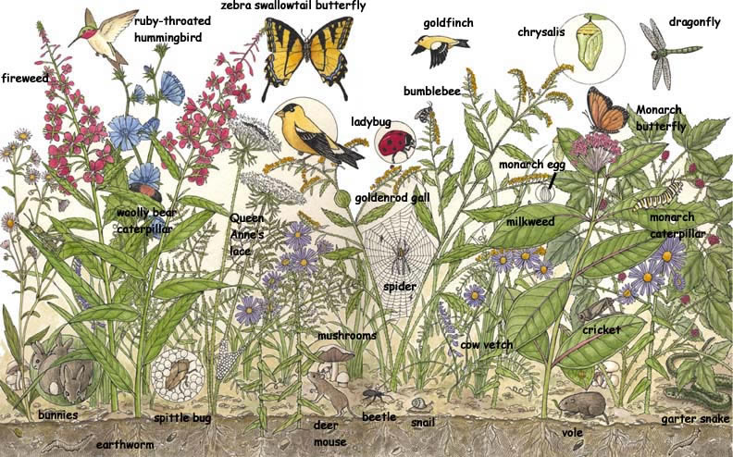
Animal life
fleet-footed hoofed animals
burrowing rodents
some rodents hibernate during winter
snakes and lizards occur, but are not diverse
amhibians tend to be rare – represented by frogs
insects (grasshopper) are the most important herbivores

Slide 9
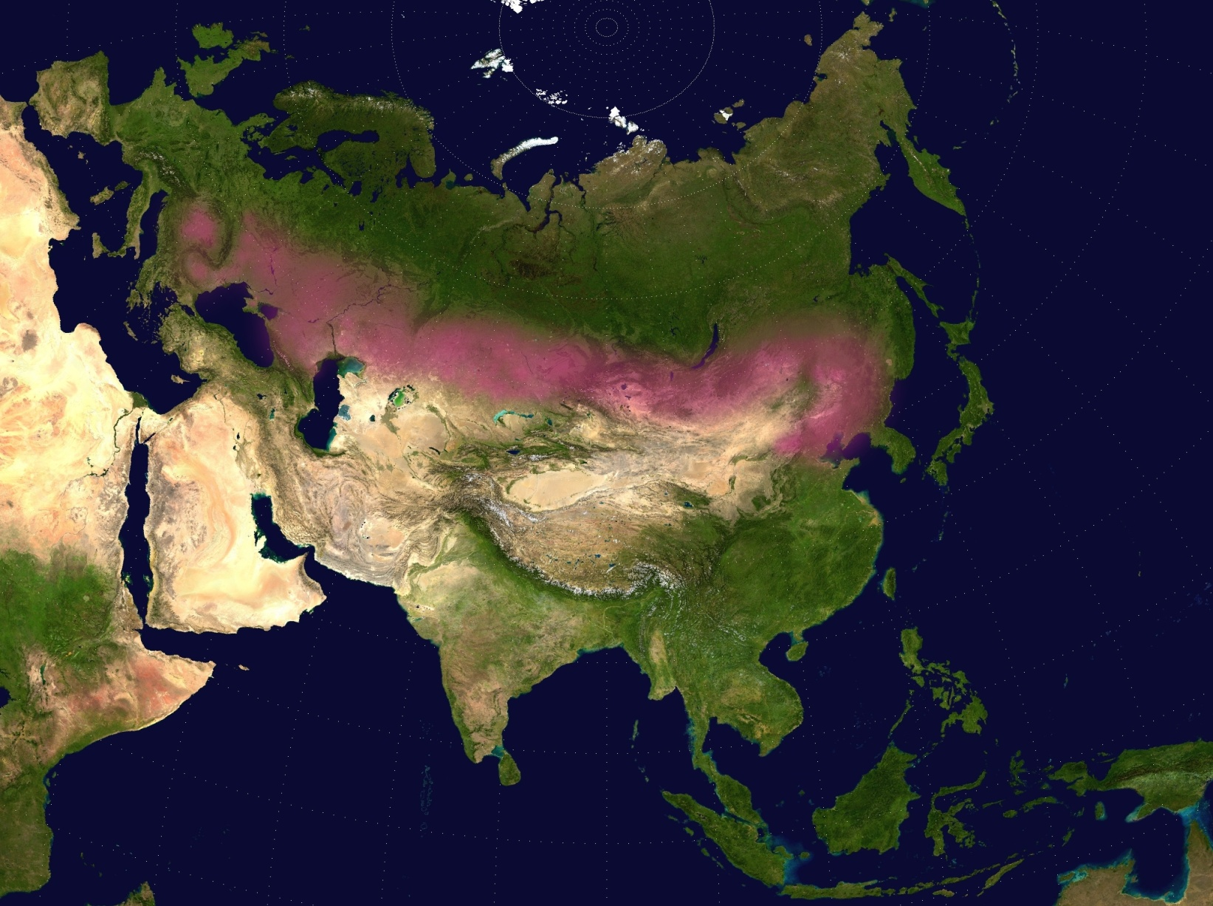
Eurasian steppes
Notes:
Steppes stratch across continent in a wide east-west belt. Across much of Russia and Mongolia is the belt 800-1000 km wide and its east-west extend is about 8000km. Differentiation of the vegetation along a moisture gradiens from moist to dry grasslands occur in latitudinal zones from north to south. The vast area has a great diversity of plant assemblages. These are grouped to 4 major types

Slide 10
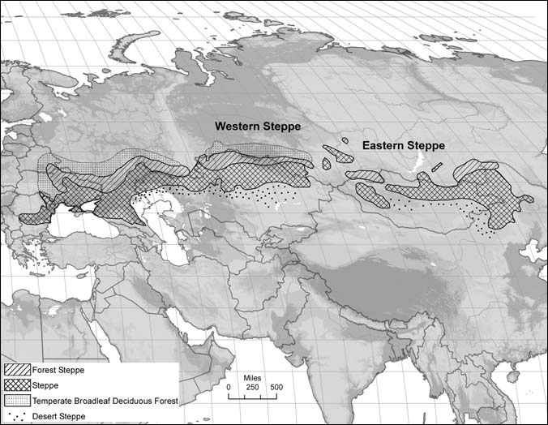
Forest steppe – a mosaic of grassland and broad-leaved deciduous forests dominated by oak in a subhumid region
True or typical steppe - characterized by bunchgrasses with many forbs in semiarid climate regions and bunchgrasses with few forbs in drier areas
Desertified bunchgrasses and dwarf shrub-bunchgrass in arid climate regions
Desert dwarf subshrub-bunchgrass steppe in the driest areas
Notes:
Trends in the vegetation are apparent from north to south. These include a decrease in the number of species present and a decrease in the height of the grass layer from 80-100cm in the north to 15-20cm in the south and a decrease in the percent cover of grasses from 70-90% to 10-20%.
Needlegrasses are the most characteristic, and the actual species vary from region to region.

Slide 11
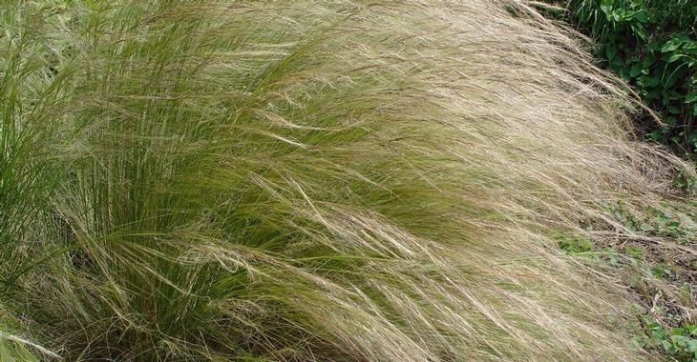
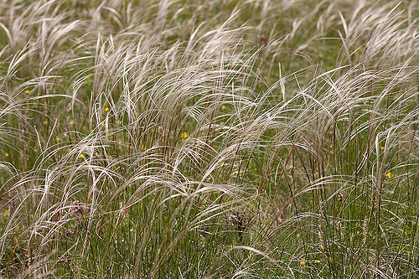
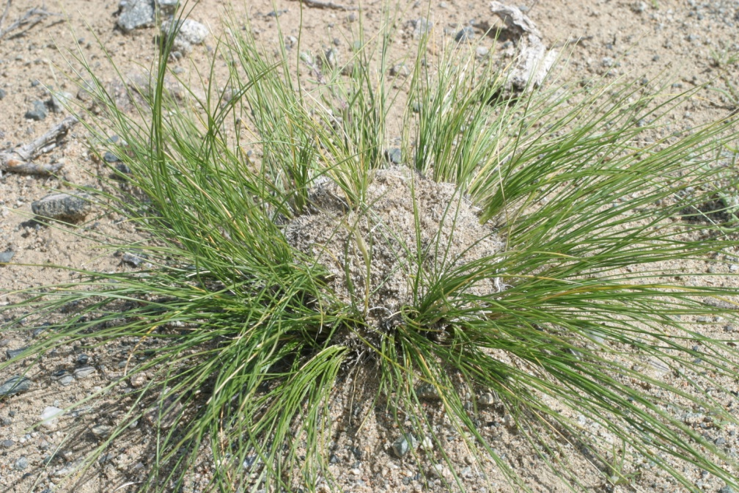
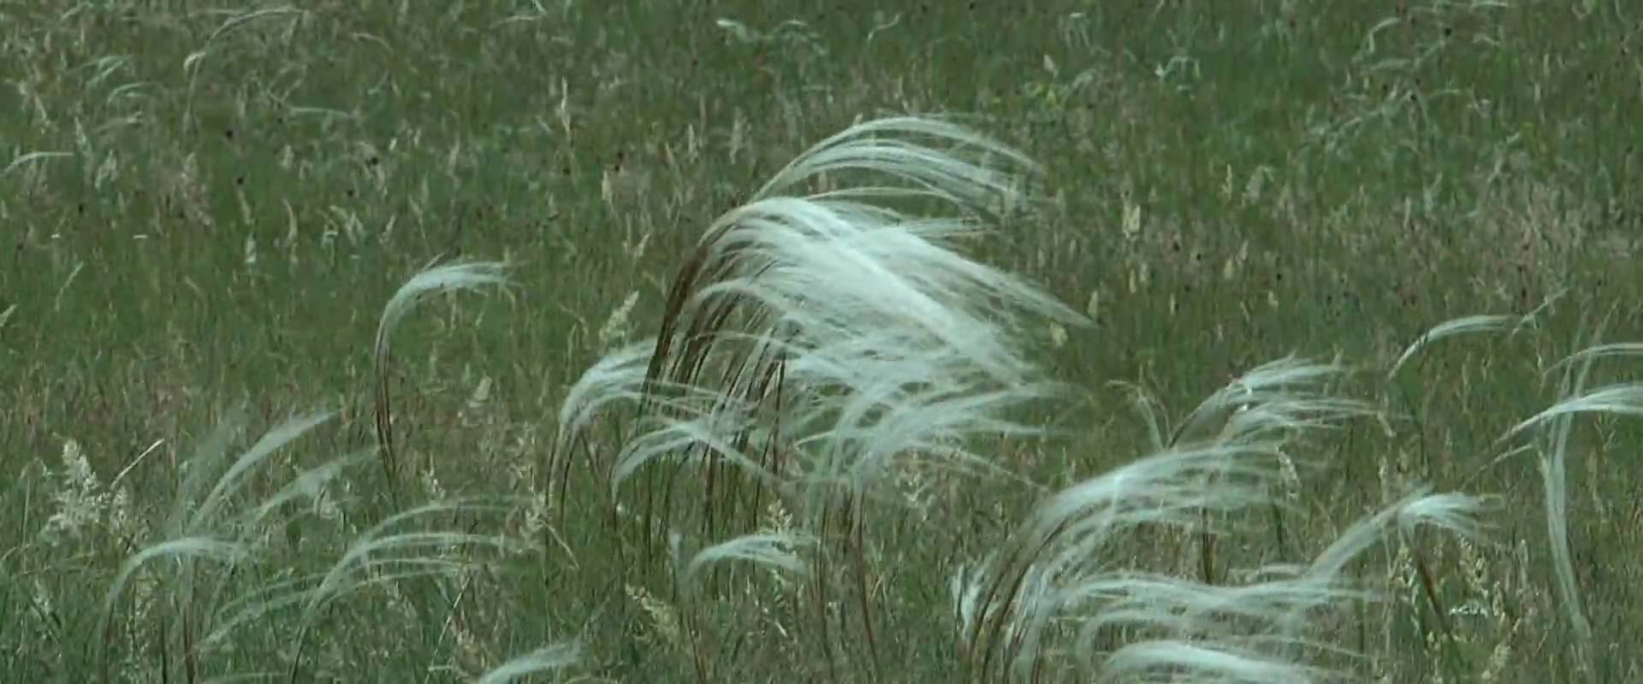
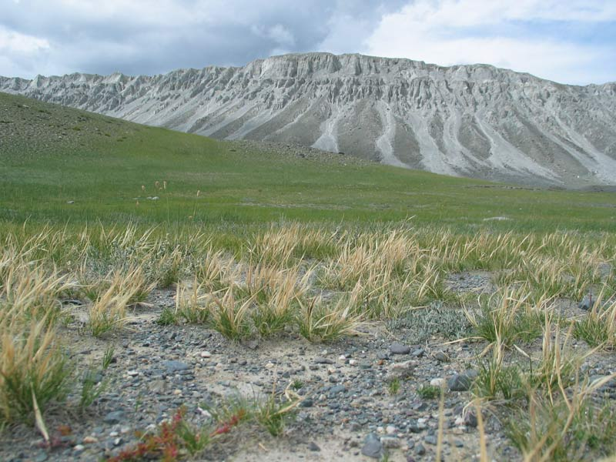
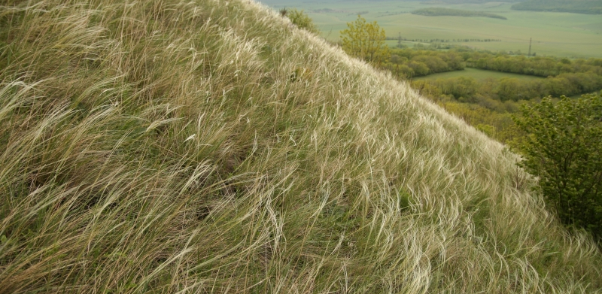
S. lessingiana
S. gobica
Stipa pennata
S. pilcherrima
S. glareosa
S. zaleskii
Notes:
In the forest steppe – stipa pennata;
in the true steppe S. Lessingiana, S. Pilcherrima, S. Zaleskii;
In the driest desert grasslands – S. Gobica, S. Glareosa.
There are also other genera of bunchgrasses. The grasses grow throughout the growing season but show slower growth rates in July and August. With them are large number of forbs with colorful flowers – they come into bloom in different times. Every color is known as aspect – e.g. In spring (early April) is in forest steppe has brown aspect; end of April – yellow aspect; end of May blue aspect; end of June – white aspect.
In Russian Central Chernozem region are 11 aspects. The number dicreases with in other regions with only 5-6 in driest areas. The number and timing of aspects vary from year to year according to actual precipitation amounts and temperatures.

Slide 12
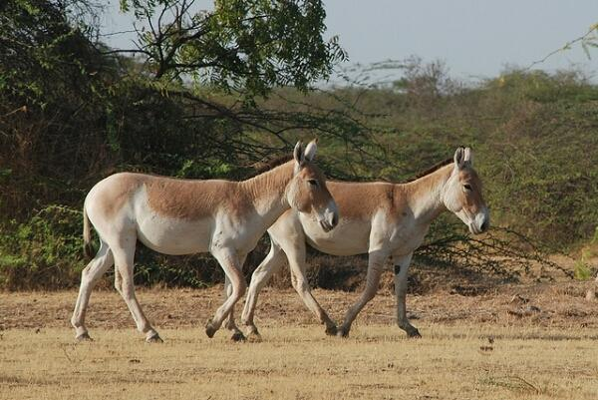
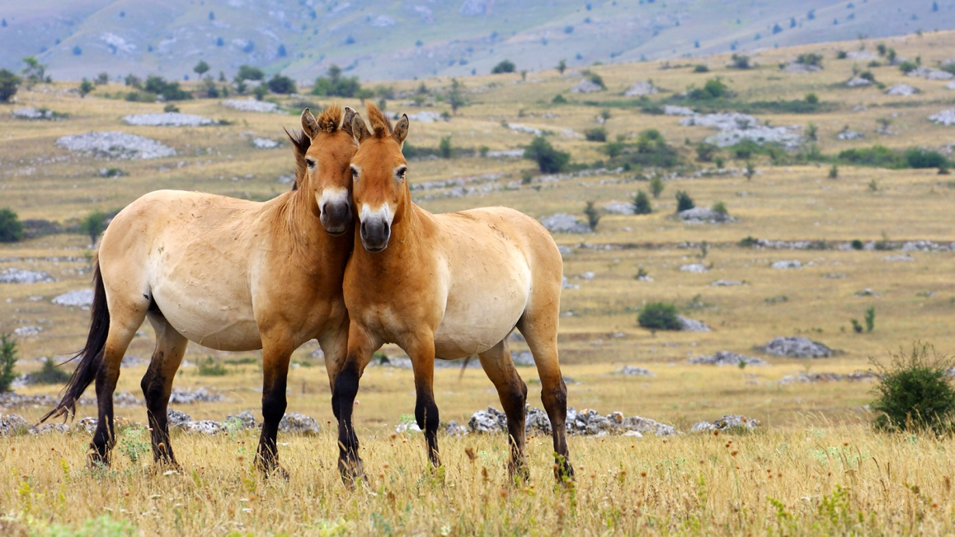
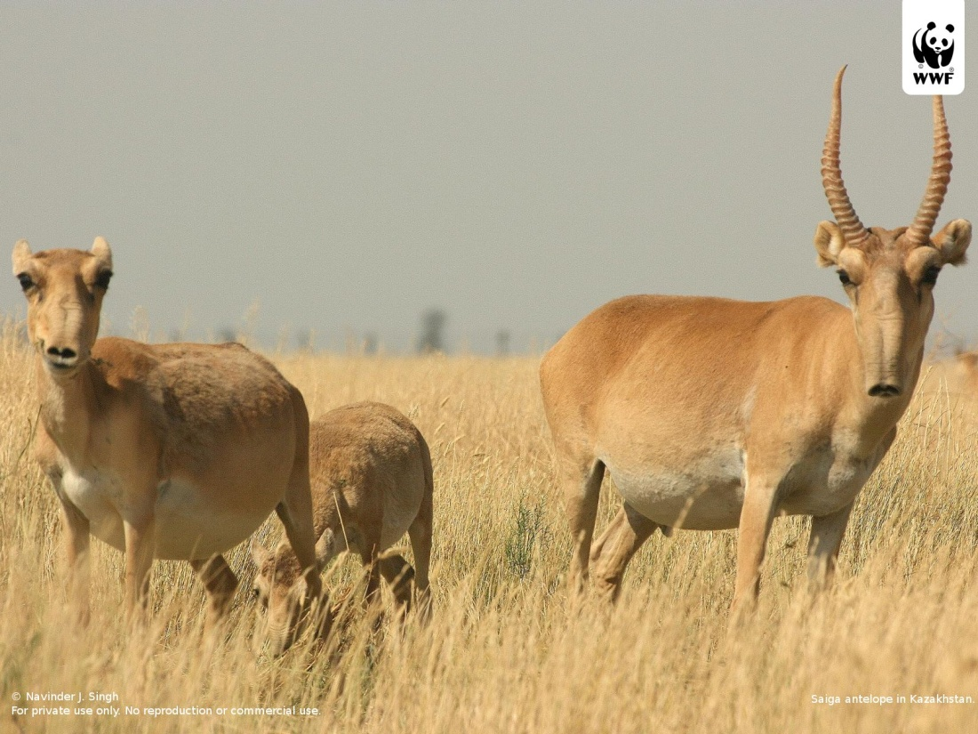
Notes:
Thousands of years of human activity have greatly altered the Eurasian steppes. Heavy grazing by domestic livestock, fire and cultivation have changed vegetation and animal life. The steppes of Mongolia are least changed and offer some idea of the earlier animal life elsewhere.
Asiatic wild ass, Przewalski´s horse, saiga

Slide 13
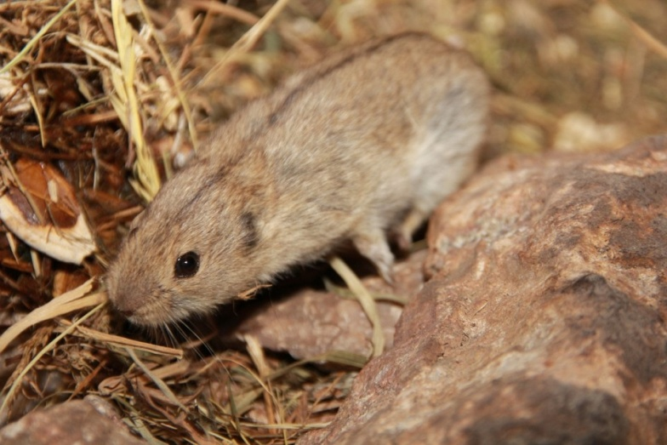
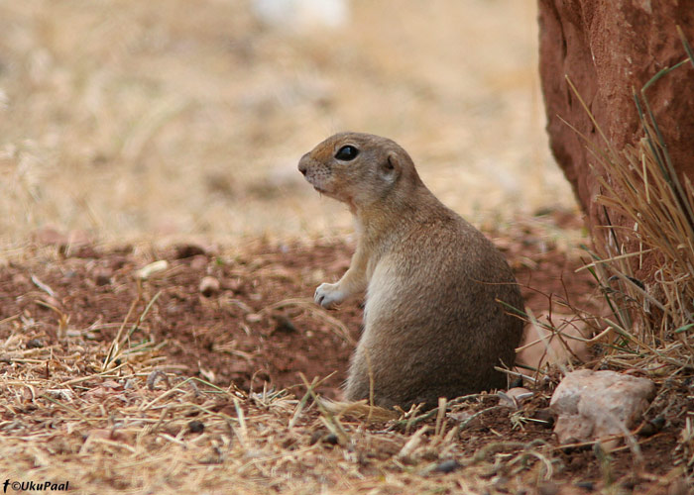
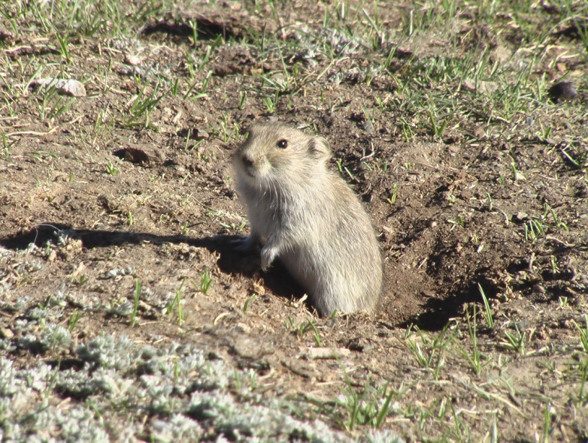
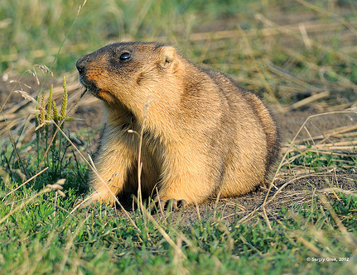
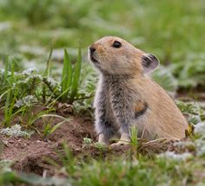
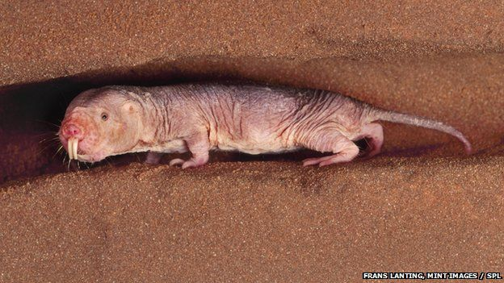
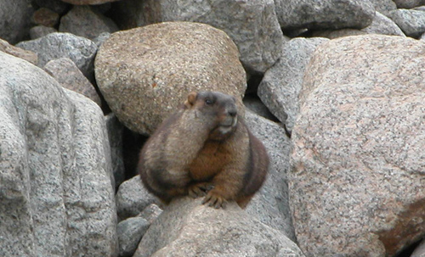
Notes:
Rodents typically dig burrows and their activities are considered major determinants of the nature soil, vegetation and microrelief in the steppe. More common redents – steppe lemming, Brand´s vole, mole rats – which is endemic, suslik, bobak, tarbagan, daurian pika.
The small mammals of the steppe do not hibernate, but accumulate stores of plant material for winter consuption.

Slide 14
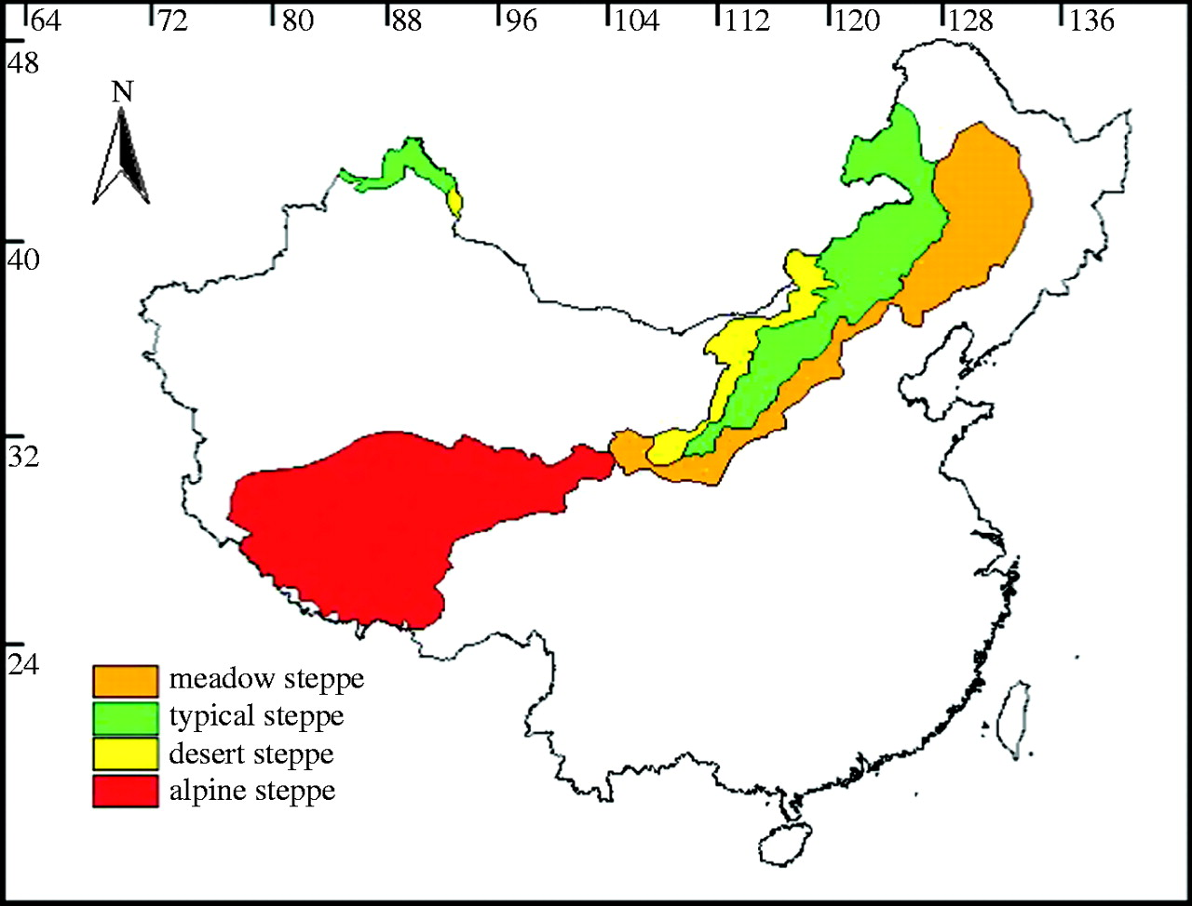
Notes:
Steppes of China are divided into 3 parts – meadow (forest) steppe, typical steppe and desert stepps. This type of steppe is greatly affected by continentality nad wind systems of Asian monsoon. Most precipitation comes between June and September and the most plants bloom between June and August. Annual precipitation is greates in the eastern part of China´s steppe 500mm and decreases to the west (200mm)

Slide 15
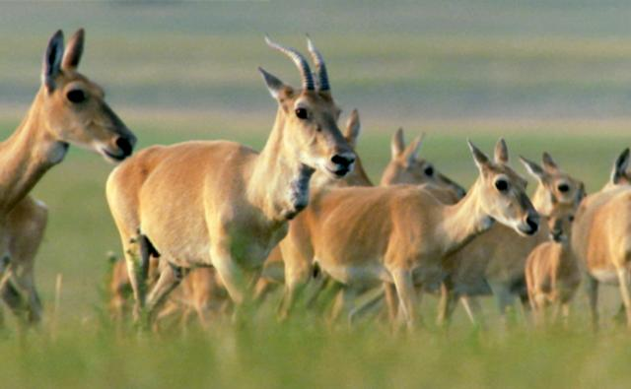
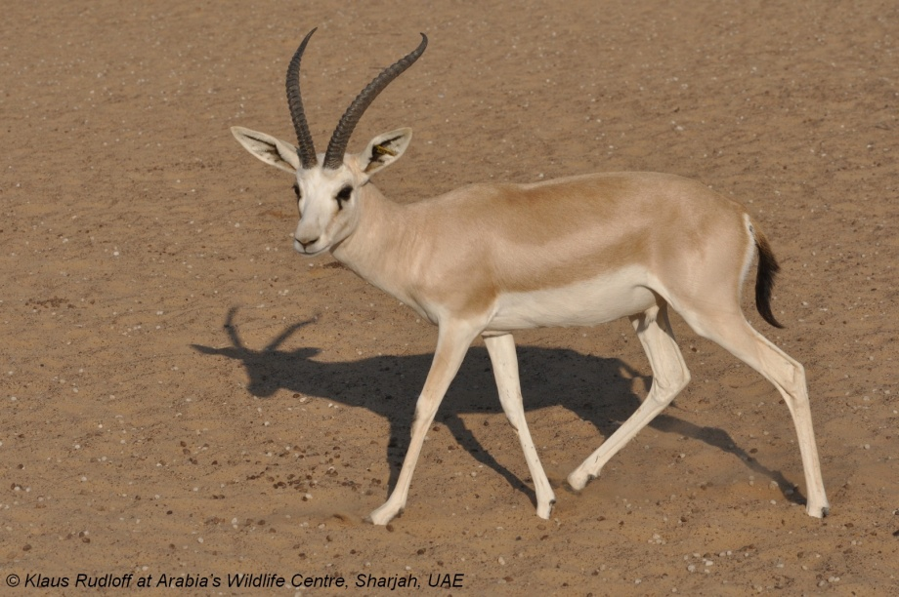
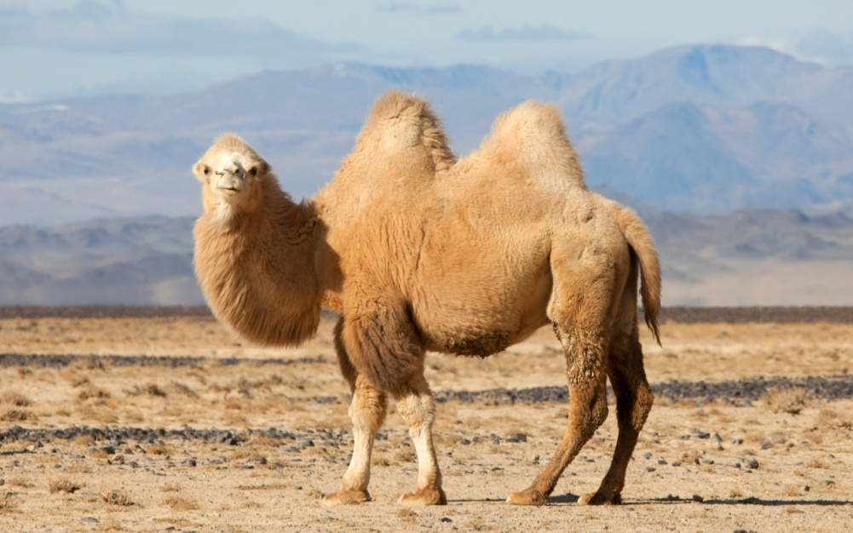
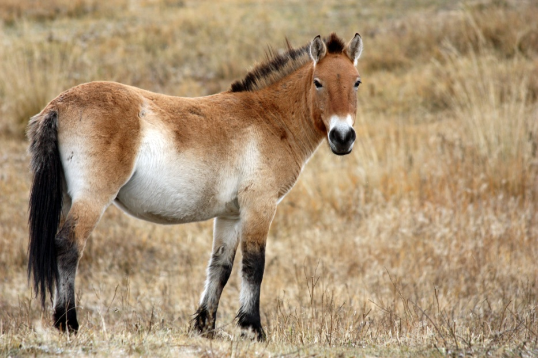
Notes:
Meadow steppe is a humid grassland at elevations 120-250m. Soils are chernozems or dark chestnut soils. Dominant grass is S.baicalensis which reaches up to 60cm. Subdominant are sod-forming grasses accompanied with perennial forbs.
Typical steppe extends from the Northeast and inner Mongolian plateau south onto Loess Plateau. Elevations in this region are 800-1400m and annual average precipitation are 300-400mm. Vegetation is uniformly low (30-50cm).
Desert steppe is in the northern and northwestern parts of Loess Plateau. Vegetation is low in diversity and height (20-30cm) and covers only about 30% of the surface. The most abundant native animals of the Chinese steppes are burrowing rodents that live in the colonies (the same as before)+mongolian gazelle, goitered gazelle, bactrial camel and takhi (both close to extinction). Few reptiles – 2 lizards and a snake; and amphibians are rare – just in the moist areas.

Slide 16
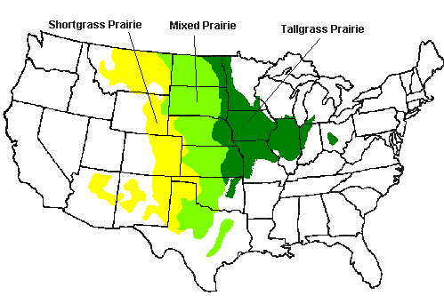
North American Prairies
Notes:
Three distinct plant groupings occur in the central grassland region – tallgrass prairie, mixed prairie, shortgrass prairie

Slide 17
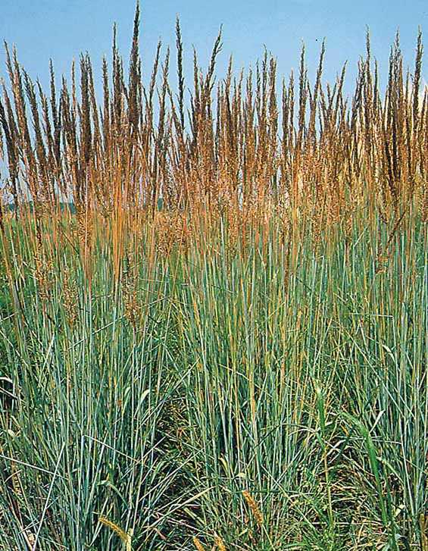
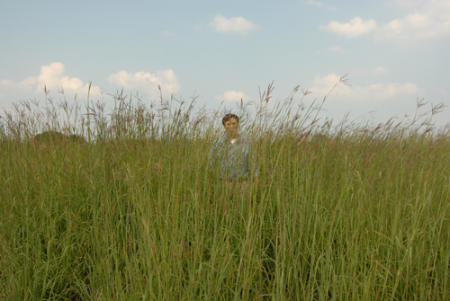
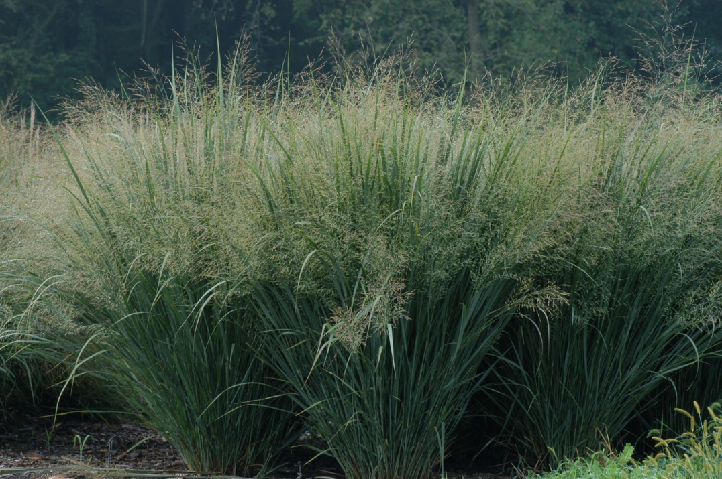
Tallgrass prairie
Big bluestem
Indian grass
Switchgrass
Notes:
It occurs in the subhumid and moister semiarid regions of the eastern prairie belt. It is a multilayer vegetation with tall grasses, midsized grasses and short grasses. Most plants are sod-forming plants and all are C4 grasses. In the late summer, when the tallest grasses have matured they may reach heights of 200-300cm. Grasses are accompanied by a variety of perennial forbs.
Prairie is associated with chernozems. Fire appears to be a major factor in maintaining the tallgrass prairie and preventing the invasions of woody species.

Slide 18
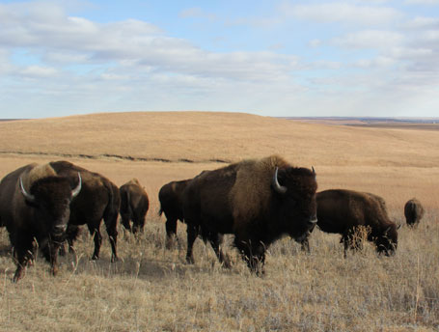
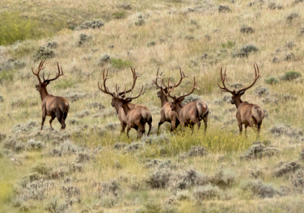
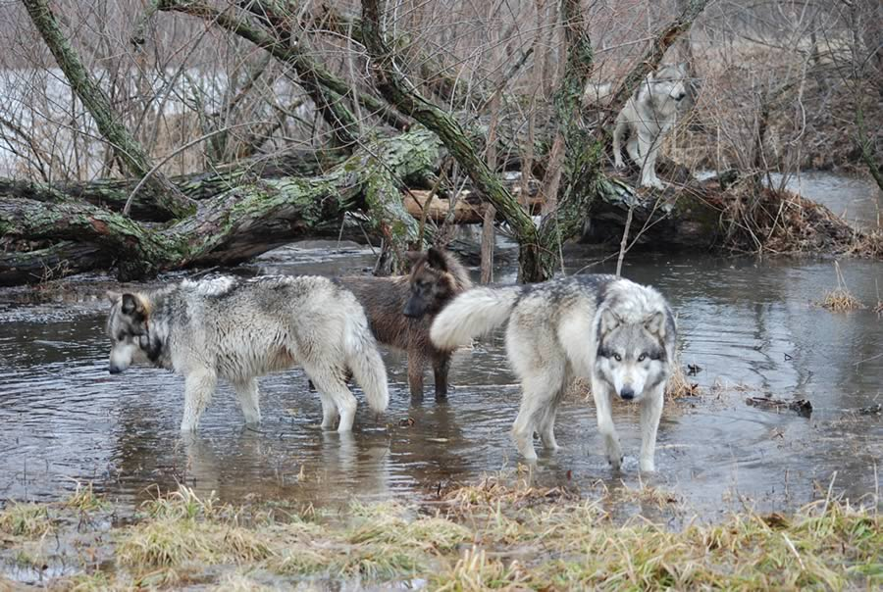
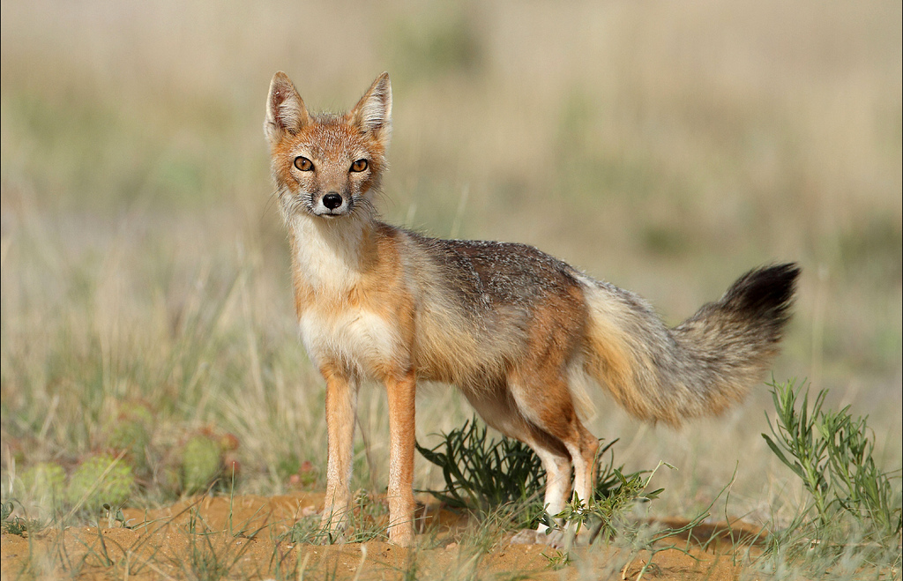
Notes:
Most of the region has been converted to agricultural land. Because of this, majority of animals are missing – gone are herds of bisons, antelope, elk, and chief predator – wolf; swift fox is no longer found in most areas. Taking their place are coyotes and red foxes. Rodents survive in rare protected areas

Slide 19
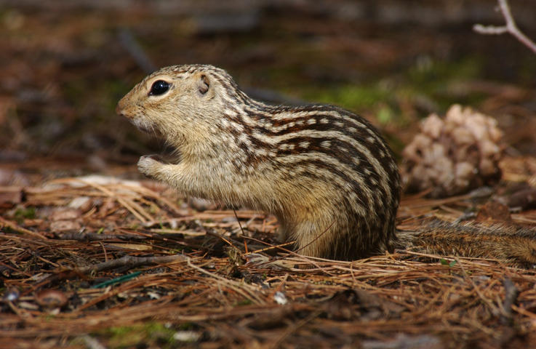
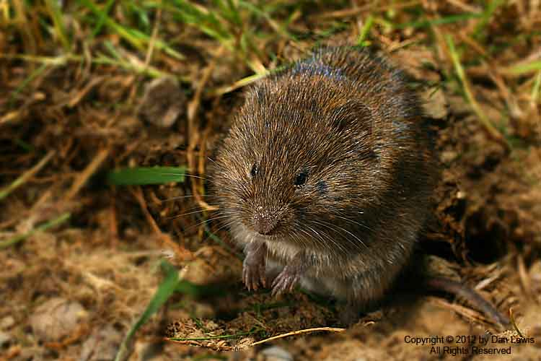
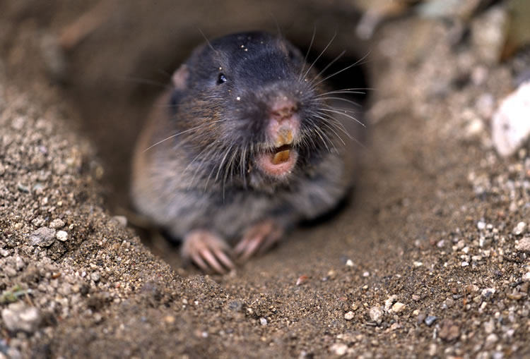
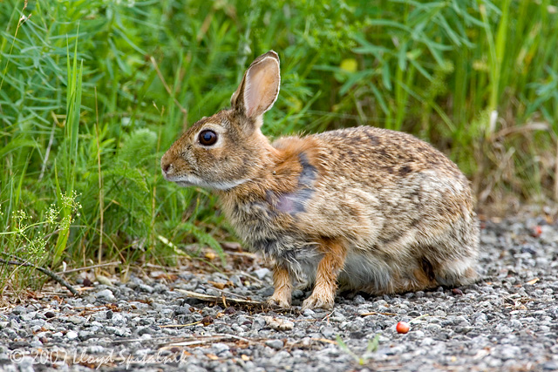
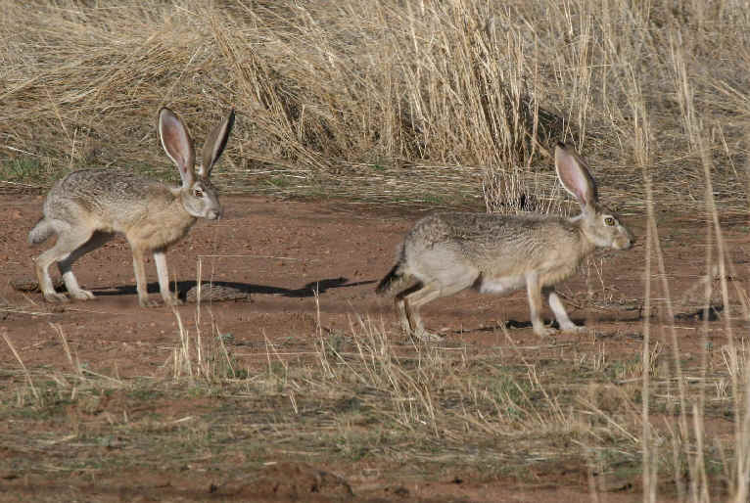
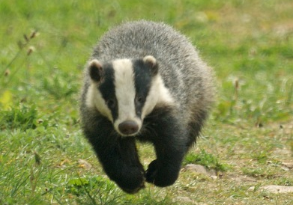
Notes:
Rodents - thirteen-line ground squirrel, meadow vole, pocket gopher.
Small herbivores – eastern cottontail, white-tailed jackrabbit
Small carnivores – badger, striped skunk and least weasel

Slide 20
Mixed prairie
Notes:
Mixed prairie is a 2layer grassland vegetation. Elevations range from 500 to 1100m. Annual precipitation varies from 600 to 350-400mm. Soils tend to be brown and chestnut colored mollisols. Vegetation consists of mixed stands of midsized (C3) and short grasses (C4). The midsized grasses stand 60-120cm, the short grasses 20-60cm. Perennial forbs are also prominent members of the plant community. Also found are halfshrubs and dwarf shrubs. Cactuses are presented as well.
Animal life is similar with this from tallgrass prairie. From reptiles is good to mention – prairie rattlesnake, plains hognose snake, bull snake

Slide 21
Shortgrass prairie
Notes:
Precipitation varies from 300-550mm with 70% occurring between May and August. Dominant plants are shallow-rooted, sod-forming grasses (10-40cm). Small shrubs and subshrubs and prairie prickly pears also occur. Short grass prairie was once a home for herds of bisons. Hares and rabbits represent the major herbivores today.

Slide 22
Notes:
Prairie-dog burrows are used by other animals (snakes, squirrels, owls) as a nesting sites or shelter.

Slide 23
South American Pampas
Notes:
Temperate grassland surrounding the Rio de la Plata. They occur undes subhumid conditions. Precipitation varies form 400-1600mm. Two rainy seasons occur – in spring and in fall. Summers are dry. Temperatures are mild, winters colder. Soils are mollisols. The southern pampas are associated with chernozems, western pampas with chestnut soils. Eastern pampas are associated with alfisols

Slide 24
Notes:
The pampas grasses include many feathergrasses – 25 species, perennial forbs and subshrubs. One type of pampa so-called rolling pampa (south of he Rio de la Plata) reach tallest plants 50-100cm. Grass community is composed of both sod-forming types and bunchgrasses in several layers. Grazing has converted this grassland to 2 layers – lover layer about 5cm high and a taller layer of bunchgrasses and small woody plants. Pampas seem to have lacked the herds of large native grazing mammals. The only large herbivore was the pampas deer. Among more abundant mammals oday are plains viscacha – large rodent that lives in colonies. Opossums, armadillos and lamas are common.

Slide 25
Notes:
Strictly South American rodents found in pampas include wild guinea pigs and tuco-tuco. The largest predators are jaguar and puma. From smaller predators – pampas cat and geoffroy´s cat.
Birds are very abundant. About 390 species have been recorded from the grasslands.

Slide 26
African Veld
Notes:
Eatern part of southern Africa at elevations 1500-5000 m. Subhumid region of summer rainfall. Annual precipitation greater than 750 mm. Summer temperatures are high – evaporation rates are high. The grassland is maintained by burning and grazing not by the climate. Mismanagement by burning at wrong time of year has changed the composition in many areas.

Slide 27
Human impacts
fire
domesticated livestock
agriculture
Notes:
Domestic livestock resulted in changes in the animal life as well as cattlemen eliminated large, potentially competing wild grazing animals as well as large carnivores. Overgrazing is associated with desertification and the invasion of shrubs

